Slide 1
Introduction to MATLAB® (for non-CS people!)
Michele Scipioni, PhD
Notes:
Hi everyone! Thanks, Valeria, for the introduction.
Well, in case you were wondering, yes, this is the first time I give a talk being almost the only person in the room, so bear with me and … let’s see how it goes!
So, the topic of today’s talk will be an introduction to the MATLAB computing environment.
There are many different way one can tackle a talk like this. For today’s talk I made the call of giving a little more attention to people with little-to-no CS background, to give them a way to start familiarizing with the platform … but I hope everyone will be able to take something from this webinar, no matter your starting level.

Slide 2





Who am I?
Michele Scipioni
Biomedical Engineer
MSc + PhD @ University of Pisa, Italy
PET
ImageReconstruction
KineticModeling
Postdoc @ Martinos Center
PET + PET/MR
ImageReconstruction
KineticModeling
PET/MR tech design and development
Nov 2019
Boston
Pisa
Ciprian Catana’s PET-MR lab
Notes:
Hi everyone,
Thanks to everybody who decided to virtually join for this first webinar version of the why&how series hosted by the martinos center.
So, the topic of today’s talk will be an introduction to the MATLAB computing environment. Ideally, I would have asked you how familiar you were with programming in general and with MATLAB, in particular, but given this new online settings I will make the call myself and I will be introducing the basics of how to use Matlab, with a particular focus on people with little-to-no CS background. We will see later on what I mean by that.

Slide 3
Overview
What?
WHY?
How?
Getting Started
Scripts, Functions, and the Editor
Visualization Tools
But … can I still use it, if I don’t know how to code?
Notes:
This is the overall outline of the talk, …

Slide 4
Overview
What?
WHY?
How?
Getting Started
Scripts, Functions, and the Editor
Visualization Tools
But … can I still use it, if I don’t know how to code?
Notes:
… but without further ado, let’s just go ahead and clarify ‘what’ we are talking about when we say ‘Matlab’.

Slide 5
General background: what are we talking about?
What is MATLAB?
MATLAB = MATrix LABoratory
High-level scripting language
Interactive visualization tool
Interactive computation tool
What can I do with MATLAB?
Automate complex data processing streams.
Analyze data.
Develop algorithms.
Create models and applications.
Write your own data analysis/computation tools.
MATLAB
is complete package made
of a programming language, computing environment, IDE, and many toolboxes for data processing and plotting.
Notes:
So, the word MATLAB comes from the full name of Matrix Laboratory, because the basic data structure in matlab are matrices, and everything is built around the idea of simplifying as much as possible matrix-vector operations.
Mathworks, which is the company behind Matlab, has built an entire framework comprising
- a high-level scripting language,
- an interactive computing environment based on a perfectly tailored graphic interface
- and an ever-growing number of additional toolboxes designed
to make of MATLAB possibly one of the easiest options when it comes to automating complex processing pipelines, visually exploring datasets, algorithm prototyping, and model development.

Slide 6
Overview
What?
WHY?
How?
Getting Started
Scripts, Functions, and the Editor
Visualization Tools
But … can I still use it, if I don’t know how to code?
Notes:
Let’s now focus on a new question:

Slide 7
Overview
What?
WHY?
How?
Getting Started
Scripts, Functions, and the Editor
Visualization Tools
But … can I still use it, if I don’t know how to code?
Notes:
Why should you start learning and using Matlab?
How does it compare with other alternatives?

Slide 8

Matlab vs C / C++ / Fortran
high level language
easy to learn
professionally developed tools and built-in functions
user-friendly GUI
(very expensive) commercial product
compiled language
(significantly) faster
general-purpose
Notes:
Well, the fact that Matlab is a scripting language makes it hard to compare it with Low- level, general-purpose, compiled languages like C/C++/Fortran.
Matlab is not designed with fast execution and high performance in mind, and to build applications from the ground up.
But on its side, Matlab combines a set of really powerful tool with being much easier to learn for people with minimum CS expertise.
An it achieves that goal by offering a full package of professionally developed tools and applications that often you can use without even needing to write a single line of code.
Clearly, this comes with the downside that Matlab is a commercial product, and a rather expensive one.

Slide 9

Matlab vs Python
interpreted languages
easy multi-OS portability
sub-optimal performance (wrt C/C++)
high level language
easy to learn
professionally developed tools and built-in functions
user-friendly GUI
(very expensive) commercial product
general-purpose
open and free
open source libraries
go-to language for machine learning and data science (at the moment)
Notes:
The comparison with Python, instead, is a bit easier.
In fact, while Python is still a true, general-purpose language, it shares with Matlab a few more similarities, like the possibility to be “treated” also as a scripting language, an overall easy portability due to both being interpreted languages, and a generally more relaxed syntax, when compared to C/C++.

Slide 10

Matlab vs R
faster!
easy to learn and intuitive
professionally developed tools and built-in functions
user-friendly GUI
‘can’ do statistics and ML, but also much more
(very expensive) commercial product
syntax closer to conventional languages
open and free
open source libraries
go-to language data analysis and statistics (at the moment)
Notes:
The roles kind of flip when we compare Matlab with a language like R.
In this case, it is R that is a more specific language, mostly focused on data analysis and statistics,
while Matlab offers a wider range of tools, while still being a pretty good option to tackle a statistics problem.
And Matlab is faster than R, and that’s not something (being faster) that happens often when we talk about Matlab.

Slide 11
Overview
What?
WHY?
How?
Getting Started
Scripts, Functions, and the Editor
Visualization Tools
But … can I still use it, if I don’t know how to code?
Notes:
Ok, so there would have been much more to say about how Matlab compares to other options, but let’s just sum it up saying that it is, as usual, a matter of pros and cons.
Matlab is really easy to approach, it has an entire company behind it focused on providing the user with the best experience no matter the level of knowledge about programming and coding, but we have to literally pay a price for that, because Matlab is a commercial product that requires a license to be used.
And this is clearly something that we have always to keep in mind.

Slide 12
Overview
What?
WHY?
How?
Getting Started
Scripts, Functions, and the Editor
Visualization Tools
But … can I still use it, if I don’t know how to code?
Notes:
But let’s just say we do have a license and want to know how we can actually start to use Matlab.
In this section, we are going to focus on basic concepts of Matlab as a programming language, to make you able, hopefully, to read and write simple code in Matlab.

Slide 13
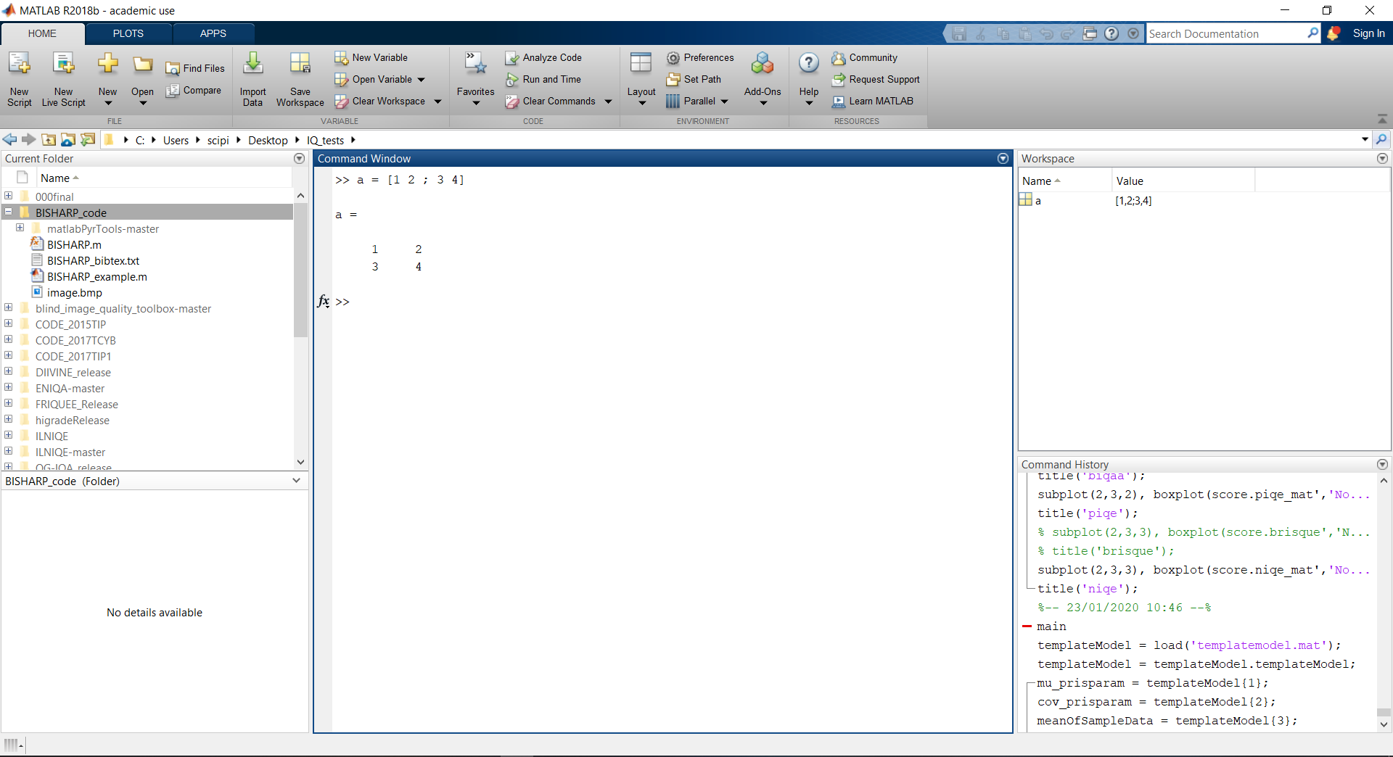
MATLAB Graphical User Interface (GUI)
5
Command window
Command history
Workspace
File explorer
Toolbar
3
4
1
2
Notes:
So, when you fire app your Matlab executable, no matter if you are on Windows, MacOS or Linux, this nice GUI pops up to give you everything you need to get started writing some code and running some scripts.
The main element here is the command windows. It may look a bit like a Unix terminal, but it is actually closer to a python console, if you are familiar with it. In there you can write any kind of command using Matlab’s own language, and as soon as you press Enter, they will be immediately executed.
On the bottom right you have the command history, where every command you typed in the command window is stored; so that you can backtrack everything you did. I have never actually checked but my fair guess is that it is able to store a few weeks/months of history.
Above the command history there is the Workspace. This is one of the best features of Matlab's GUI as in there you see a list of every variable you defined by running your code so that in every moment you can be aware of what names are already taken, and what variable you can call from the command windows to interact with them.
On the left, we have the file explorer which shows us the folder we are in and everything inside of it. This is important because this is the way we can decide the working directory in which our code will be executed, and because if we need to read some files, we need to know where we are and if we can access it or not.
On the top, there’s the toolbar menu, which reflects the style of the ribbon menu of the Office suite. Using commands in this menu we can perform most of the operations related to writing and running Matlab scripts.

Slide 14
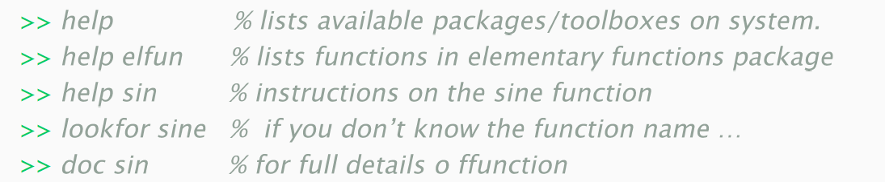
MATLAB syntax – Looking for help!
Don’t be scared to ask for help!
In many case, the documentation texts are quite informative and educational.
Notes:
The first really good thing about Matlab being a commercial product is that commercial products are usually really good when it comes to writing quality documentation.
There are many ways you can ask for help in Matlab, but the two most common ones are typing help or doc, followed by the name of the function you want to know more about.
Using help, you will get a short summary of the main properties of a function, printed directly in the command window.
Using doc, instead, you will fire up the actual documentation, with an in-depth description of everything you can do with a certain function, a few examples of usage, and also a lot of theory and implementation details.
So I’d really suggest you use it as much as possible.

Slide 15
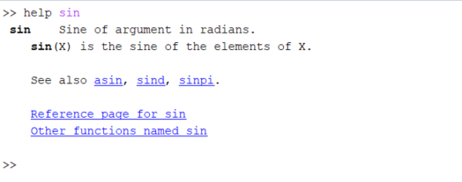
MATLAB syntax – Looking for help!
Don’t be scared to ask for help!
In many case, the documentation texts are quite informative and educational.
Notes:
The first really good thing about Matlab being a commercial product is that commercial products are usually really good when it comes to writing quality documentation.
There are many ways you can ask for help in Matlab, but the two most common ones are typing help or doc, followed by the name of the function you want to know more about.
Using help, you will get a short summary of the main properties of a function, printed directly in the command window.
Using doc, instead, you will fire up the actual documentation, with an in-depth description of everything you can do with a certain function, a few examples of usage, and also a lot of theory and implementation details.
So I’d really suggest you use it as much as possible.

Slide 16
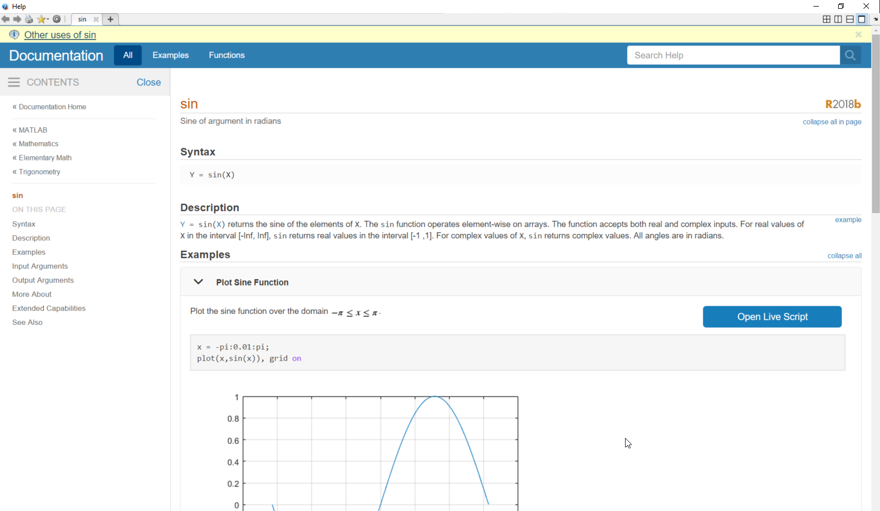
MATLAB syntax – Looking for help!
Don’t be scared to ask for help!
In many case, the documentation texts are quite informative and educational.
Notes:
The first really good thing about Matlab being a commercial product is that commercial products are usually really good when it comes to writing quality documentation.
There are many ways you can ask for help in Matlab, but the two most common ones are typing help or doc, followed by the name of the function you want to know more about.
Using help, you will get a short summary of the main properties of a function, printed directly in the command window.
Using doc, instead, you will fire up the actual documentation, with an in-depth description of everything you can do with a certain function, a few examples of usage, and also a lot of theory and implementation details.
So I’d really suggest you use it as much as possible.

Slide 17
MATLAB syntax – Matrices, vectors, arrays …
Scalar
>> s = 5; % no need to specify data type (default is double)
Vector
>> a = [1, 2, 3]; % row vector
>> b = [4; 5; 6]; % column vector
Matrix
>> A = [1, 2, 3 ; 4, 5, 6 ; 7, 8, 9]; % 3 x 3 matrix
Notes:
After learning how to ask for help, the second most important thing to remember is that Matlab stands for Matrix Laboratory, so knowing how to define matrices, vectors, array, is key.
Something that makes Matlab way easier the most programming languages is that we don’t need to be too detailed when instantiating variables.
We don’t need to specify the type or allocate memory. We just need to choose a name and set a value.
One value means our variable is a scalar, more than one means that it is an array.
If we want to create a vector, a 1D array, we can use square brackets and list all the values in it.
If we use commas to separates values, we will get a row vector,

Slide 18
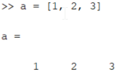
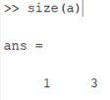
MATLAB syntax – Matrices, vectors, arrays …
Scalar
>> s = 5; % no need to specify data type (default is double)
Vector
>> a = [1, 2, 3]; % row vector
>> b = [4; 5; 6]; % column vector
Matrix
>> A = [1, 2, 3 ; 4, 5, 6 ; 7, 8, 9]; % 3 x 3 matrix
Notes:
After learning how to ask for help, the second most important thing to remember is that Matlab stands for Matrix Laboratory, so knowing how to define matrices, vectors, array, is key.
Something that makes Matlab way easier the most programming languages is that we don’t need to be too detailed when instantiating variables.
We don’t need to specify the type or allocate memory. We just need to choose a name and set a value.
One value means our variable is a scalar, more than one means that it is an array.
If we want to create a vector, a 1D array, we can use square brackets and list all the values in it.
If we use commas to separates values, we will get a row vector,

Slide 19
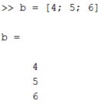
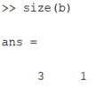
MATLAB syntax – Matrices, vectors, arrays …
Scalar
>> s = 5; % no need to specify data type (default is double)
Vector
>> a = [1, 2, 3]; % row vector
>> b = [4; 5; 6]; % column vector
Matrix
>> A = [1, 2, 3 ; 4, 5, 6 ; 7, 8, 9]; % 3 x 3 matrix
Notes:
if instead, we use semicolons, we will get a column vector.

Slide 20
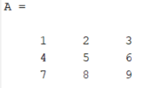
MATLAB syntax – Matrices, vectors, arrays …
Scalar
>> s = 5; % no need to specify data type (default is double)
Vector
>> a = [1, 2, 3]; % row vector
>> b = [4; 5; 6]; % column vector
Matrix
>> A = [1, 2, 3 ; 4, 5, 6 ; 7, 8, 9]; % 3 x 3 matrix
Use percent (%) sign to start a comment (everything after it IS NOT code)
Suppress (interactive console) output by adding a semicolon (;) at the end of each line
Notes:
It may be easier to grasp the difference by looking at a matrix.
This is how we define a 3 by 3 matrix: we use commas to separate elements on the same row, and semicolons to separate different rows in the matrix.
Other interesting characters it is important to keep in mind are
- the percentage sign, which is used for inline comments,
- and the semicolon at the end of each instruction. …

Slide 21
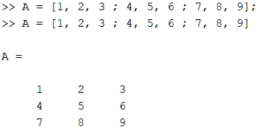
MATLAB syntax – Matrices, vectors, arrays …
Scalar
>> s = 5; % no need to specify data type (default is double)
Vector
>> a = [1, 2, 3]; % row vector
>> b = [4; 5; 6]; % column vector
Matrix
>> A = [1, 2, 3 ; 4, 5, 6 ; 7, 8, 9]; % 3 x 3 matrix
Use percent (%) sign to start a comment (everything after it IS NOT code)
Suppress (interactive console) output by adding a semicolon (;) at the end of each line
Notes:
If we skip the semicolon at the end of each line,
after each instruction we will get the output directly printed on the interactive console.
Most of the time we don’t want that
- because it is annoying,
- but also because printing to console slows down the code significantly.
So, don’t forget the semicolon!

Slide 22
MATLAB syntax – Matrices, vectors, arrays …
Functions to create matrices
>> zeros(5,3); % All zeros
>> ones(8,5); % All ones
>> eye(5); % Identity matrix
>> rand(3,9); % Uniformly distributed random numbers (between 0 and 1)
>> randn(10,5); % Normally distributed random numbers (mean 0 and var 1)
Notes:
As you can imagine, manually typing all the values in your arrays is not the only way you can use to create them.
There is a long list of functions you can use to instantiate arrays of predefined shape, filled for instance with zeros, ones or random numbers …

Slide 23
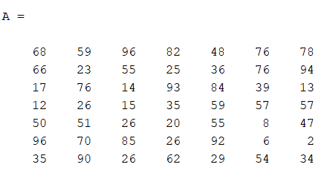
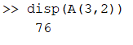
MATLAB syntax – Matrices, vectors, arrays …
matrix indexing / slicing
In MATLAB matrix and vector indexing start from 1 (not from 0).
It uses a column-major convention (it affects reshaping and transpositions)
>> A(3,2) % Access a single element (3rd row, 2nd col)
Notes:
Once we created our array, we may want to access elements of it. This action is called indexing or slicing, and to do that in Matlab, it’s important to keep in mind that indexing starts from 1, and not from 0 as usual for many other languages.
For instance, if we want to access the element 3,2 of this matrix A, we will use parenthesis, and we will get the element on the third row, second column.

Slide 24
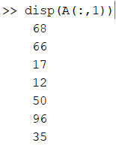
MATLAB syntax – Matrices, vectors, arrays …
matrix indexing / slicing
In MATLAB matrix and vector indexing start from 1 (not from 0).
It uses a column-major convention (it affects reshaping and transpositions)
>> A(3,2) % Access a single element (3rd row, 2nd col)
>> A(:,1) % Select the whole 1° column
Notes:
If instead, we want to extract the entire first column from A, this is as simple as using a colon
A colon in the first position means that we want to select ALL elements on the first dimension of our array,
and the number 1 in the second spot means that we want just the first element of the second dimension.
The same will do if we want an entire row, but we will have to switch the order.

Slide 25
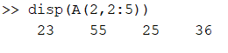
MATLAB syntax – Matrices, vectors, arrays …
matrix indexing / slicing
In MATLAB matrix and vector indexing start from 1 (not from 0).
It uses a column-major convention (it affects reshaping and transpositions)
>> A(3,2) % Access a single element (3rd row, 2nd col)
>> A(:,1) % Select the whole 1° column
>> A(2,2:5) % Select a subset of 2° row
Notes:
If instead, we want just a subset of the second row, we can use this syntax, where we specify the first and last columns we are interested in.
Differently from Python and other languages, both indexes 2 and 5 will be included in slicing.

Slide 26
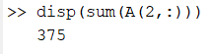
MATLAB syntax – Matrices, vectors, arrays …
matrix indexing / slicing
In MATLAB matrix and vector indexing start from 1 (not from 0).
It uses a column-major convention (it affects reshaping and transpositions)
>> A(3,2) % Access a single element (3rd row, 2nd col)
>> A(:,1) % Select the whole 1° column
>> A(2,2:5) % Select a subset of 2° row
>> sum(A(2,:)) % Sum all elements of 2° row
Notes:
More then that, operation of indexing and slicing can be directly combined with other operations.
For instance, we can sum all the element on second row by simply using this syntax …

Slide 27
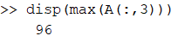
MATLAB syntax – Matrices, vectors, arrays …
matrix indexing / slicing
In MATLAB matrix and vector indexing start from 1 (not from 0).
It uses a column-major convention (it affects reshaping and transpositions)
>> A(3,2) % Access a single element (3rd row, 2nd col)
>> A(:,1) % Select the whole 1° column
>> A(2,2:5) % Select a subset of 2° row
>> sum(A(2,:)) % Sum all elements of 2° row
>> max(A(:,3)) % Max value of 3° column
Notes:
… Or we can compute the maximum value of the 3rd column in this way.

Slide 28
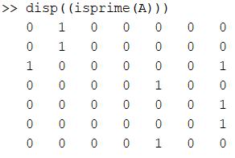
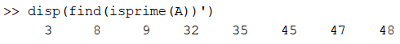
MATLAB syntax – Matrices, vectors, arrays …
matrix indexing / slicing
In MATLAB matrix and vector indexing start from 1 (not from 0).
It uses a column-major convention (it affects reshaping and transpositions)
>> A(3,2) % Access a single element (3rd row, 2nd col)
>> A(:,1) % Select the whole 1° column
>> A(2,2:5) % Select a subset of 2° row
>> sum(A(2,:)) % Sum all elements of 2° row
>> max(A(:,3)) % Max value of 3° column
>> find(isprime(A)) % Index of prime numbers among all elements
column-major indexes!

Slide 29
MATLAB syntax – Matrices, vectors, arrays …
Vector operations
>> a + 3 % Add a scalar to a vector
>> a * 3 % Multiply a scalar and a vector
>> pinv(a) % Moore-Penrose pseudoinverse
>> norm(b) % norm of a vector
>> a’ % transpose
Elementwise ops [ MUST BE same size! ]
>> a + b % vector addition
>> a - b % vector subtraction
>> a .* b % vector multplication
>> a ./ b % vector division
MUST BE of compatible size!
>> a * c % dot product
>> dot(a,c) % dot product
>> a / b % equiv to a*pinv(b)
Notes:
So this covers pretty much the basics of array creation and manipulation.
Then, as I said, Matlab is really built around the idea of making it AS easier and intuitive AS possible working with multidimensional arrays.
In this slide, I list a lot of basic operations you can do on a vector, a 1D array.
We are not going to discuss all of them, but you can use it as a cheat sheet if you want.
I just want to focus your attention on a couple of interesting operations.
Let’s say we have 3 vectors. A and B are row vectors, because we used commas when listing the elements; C is a column vector, because of the semicolons. Ok?
Well, transposing a vector in Matlab is as simple as using an apostrophe after the name of the vector. As you can see, we get a column vector as a result.

Slide 30
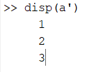
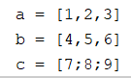
MATLAB syntax – Matrices, vectors, arrays …
Vector operations
>> a + 3 % Add a scalar to a vector
>> a * 3 % Multiply a scalar and a vector
>> pinv(a) % Moore-Penrose pseudoinverse
>> norm(b) % norm of a vector
>> a’ % transpose
Elementwise ops [ MUST BE same size! ]
>> a + b % vector addition
>> a - b % vector subtraction
>> a .* b % vector multplication
>> a ./ b % vector division
MUST BE of compatible size!
>> a * c % dot product
>> dot(a,c) % dot product
>> a / b % equiv to a*pinv(b)
Notes:
So this covers pretty much the basics of array creation and manipulation.
Then, as I said, Matlab is really built around the idea of making it AS easier and intuitive AS possible working with multidimensional arrays.
In this slide, I list a lot of basic operations you can do on a vector, a 1D array.
We are not going to discuss all of them, but you can use it as a cheat sheet if you want.
I just want to focus your attention on a couple of interesting operations.
Let’s say we have 3 vectors. A and B are row vectors, because we used commas when listing the elements; C is a column vector, because of the semicolons. Ok?
Well, transposing a vector in Matlab is as simple as using an apostrophe after the name of the vector. As you can see, we get a column vector as a result.

Slide 31
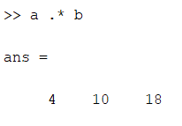
MATLAB syntax – Matrices, vectors, arrays …
Vector operations
>> a + 3 % Add a scalar to a vector
>> a * 3 % Multiply a scalar and a vector
>> pinv(a) % Moore-Penrose pseudoinverse
>> norm(b) % norm of a vector
>> a’ % transpose
Elementwise ops [ MUST BE same shape! ]
>> a + b % vector addition
>> a - b % vector subtraction
>> a .* b % vector multplication
>> a ./ b % vector division
MUST BE of compatible shape!
>> a * c % dot product
>> dot(a,c) % dot product
>> a / b % equiv to a*pinv(b)
Notes:
Then another interesting syntax choice is when we want to perform element-by-element operations between arrays with the same shape.
Elementwise multiplication between two row vectors can be performed by pre-pending a dot to the star operator.
As a result, we get a new row vector, with each element resulting from …

Slide 32
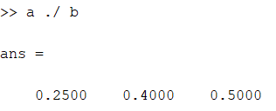
MATLAB syntax – Matrices, vectors, arrays …
Vector operations
>> a + 3 % Add a scalar to a vector
>> a * 3 % Multiply a scalar and a vector
>> pinv(a) % Moore-Penrose pseudoinverse
>> norm(b) % norm of a vector
>> a’ % transpose
Elementwise ops [ MUST BE same shape! ]
>> a + b % vector addition
>> a - b % vector subtraction
>> a .* b % vector multplication
>> a ./ b % vector division
MUST BE of compatible shape!
>> a * c % dot product
>> dot(a,c) % dot product
>> a / b % equiv to a*pinv(b)
Notes:
And the same goes for elementwise division, obviously.

Slide 33
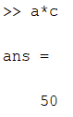
MATLAB syntax – Matrices, vectors, arrays …
Vector operations
>> a + 3 % Add a scalar to a vector
>> a * 3 % Multiply a scalar and a vector
>> pinv(a) % Moore-Penrose pseudoinverse
>> norm(b) % norm of a vector
>> a’ % transpose
Elementwise ops [ MUST BE same shape! ]
>> a + b % vector addition
>> a - b % vector subtraction
>> a .* b % vector multplication
>> a ./ b % vector division
MUST BE of compatible shape!
>> a * c % dot product
>> dot(a,c) % dot product
>> a / b % equiv to a*pinv(b)
Notes:
If we don’t use a dot and we just call for a ‘star’ product, we are implicitly asking Matlab to perform a dot-product between the two vectors.
Clearly, this can be done only if the shape of the two arrays is suitable for dot product.
In this case, we are multiplying a 1 by 3 vector for a 3 by 1 vector, and the result is a scalar, as expected.

Slide 34
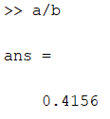
MATLAB syntax – Matrices, vectors, arrays …
Vector operations
>> a + 3 % Add a scalar to a vector
>> a * 3 % Multiply a scalar and a vector
>> pinv(a) % Moore-Penrose pseudoinverse
>> norm(b) % norm of a vector
>> a’ % transpose
Elementwise ops [ MUST BE same shape! ]
>> a + b % vector addition
>> a - b % vector subtraction
>> a .* b % vector multplication
>> a ./ b % vector division
MUST BE of compatible shape!
>> a * c % dot product
>> dot(a,c) % dot product
>> a / b % equiv to a*pinv(b)
Notes:
Apostrophe
Star
Slash

Slide 35
MATLAB syntax – Matrices, vectors, arrays …
matrix operations
>> pinv(A) % Pseudoinverse of a matrix
>> det(A) % Determinant of a matrix
>> A .^ 3 % Elementwise power
>> A‘ % Transpose
MUST BE of compatible shape!
>> A * C % Matrix multiplication
>> A * a % Matrix-vector product
>> A / B % A*inv(B)
>> A \ B % inv(A)*B
>> A + 3 % Add a scalar
>> A * 3 % Multiply a scalar
>> sin(A) % Elementwise sine
>> exp(A) % Elementwise exponential
>> inv(A) % Inverse of a matrix
Elementwise ops [ MUST BE same shape! ]
>> A + B % Matrices addition
>> A .* B % Matrices multplication
>> A ./ B % Matrices division
Notes:
Working with matrices, which in general are just n-dimensional arrays, is no more difficult than working with vectors.
The interface to basic operations is the same:
we can still use dot operator for element-by-element operations,
the apostrophe for transposition, and so on.

Slide 36
MATLAB syntax – Matrices, vectors, arrays …
matrix operations
>> pinv(A) % Pseudoinverse of a matrix
>> det(A) % Determinant of a matrix
>> A .^ 3 % Elementwise power
>> A‘ % Transpose
MUST BE of compatible shape!
>> A * C % Matrix multiplication
>> A * a % Matrix-vector product
>> A / B % A*inv(B)
>> A \ B % inv(A)*B
>> A + 3 % Add a scalar
>> A * 3 % Multiply a scalar
>> sin(A) % Elementwise sine
>> exp(A) % Elementwise exponential
>> inv(A) % Inverse of a matrix
Elementwise ops [ MUST BE same shape! ]
>> A + B % Matrices addition
>> A .* B % Matrices multplication
>> A ./ B % Matrices division
Notes:
Working with matrices, which in general are just n-dimensional arrays, is no more difficult than working with vectors.
The interface to basic operations is the same:
we can still use dot operator for element-by-element operations,
the apostrophe for transposition, and so on.

Slide 37
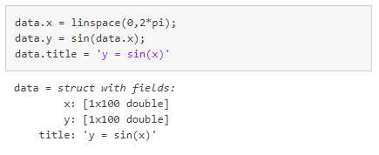
MATLAB syntax – ‘Unusual’ data structures
What is a ‘struct’ in matlab?
A structure array is a data type that groups related data using data containers called fields.
Each field can contain any type of data.
Access data in a field using dot notation of the form structName.fieldName
Notes:
Other than simple arrays. There two less common data types that you may find quite often in Matlab scripts. The first one is Structure, and it is a sort of a container of labeled data. It is similar to a Python dictionary if you know what I am talking about. Each label identifies a field in the structure, and each field can contain any type of data. The simplest way to build a structure is by using dot notation, like this. Here our struct has 3 fields: two of them are arrays, the third one is a string.

Slide 38
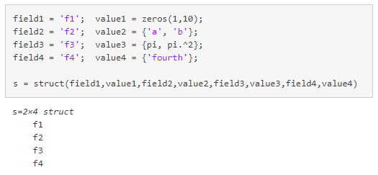
MATLAB syntax – ‘Unusual’ data structures
What is a ‘struct’ in matlab?
A structure array is a data type that groups related data using data containers called fields.
Each field can contain any type of data.
Access data in a field using dot notation of the form structName.fieldName
Notes:
As an alternative, we can use the function ‘struct’ to create a new structure by passing a list of field-names and field-values as inputs. In this case, out struct as shape 2 by 4, meaning that we actually created 2 structures each one with 4 fields.

Slide 39
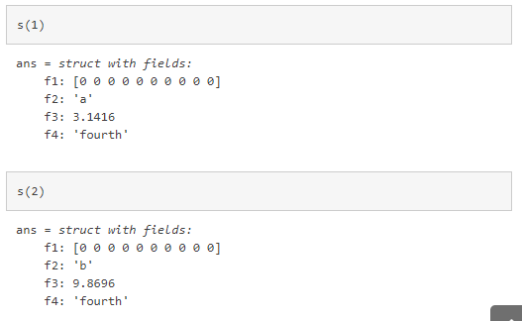
MATLAB syntax – ‘Unusual’ data structures
What is a ‘struct’ in matlab?
A structure array is a data type that groups related data using data containers called fields.
Each field can contain any type of data.
Access data in a field using dot notation of the form structName.fieldName
Notes:
We can use parenthesis to access the two sub-structures

Slide 40
MATLAB syntax – ‘Unusual’ data structures
What is a ‘struct’ in matlab?
A structure array is a data type that groups related data using data containers called fields.
Each field can contain any type of data.
Access data in a field using dot notation of the form structName.fieldName

Slide 41
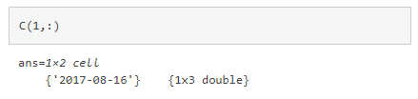
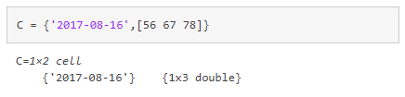
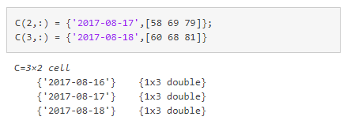
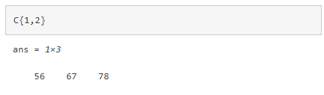
MATLAB syntax – ‘Unusual’ data structures
What about ‘cell arrays’?
A cell array is a data type with indexed data containers called cells
Each cell can contain any type of data.
Creation
When you have data to put into a cell array, create the array using the cell array construction operator, {}.
Indexing
When you index with smooth parentheses, (), the result is a cell array that is a subset of the cell array.
When you index with curly braces, {}, the result is the data that is contained in the specified cell.
Notes:
The other special data type which is typical of Matlab code is the so-called ‘cell array’. A cell array is an indexed data container that groups together ‘cells’ of data. Each cell can contain any type of data. To create a cell array you can use curly brackets: everything within these brackets will be part of a cell in our array, and elements of a cell are separated by commas. Unlike structures, the shape of each cell should be consistent. Additionally, you can use both parenthesis and curly brackets to index a cell array. When you use parenthesis, the output will still be a cell array that is a subset of the original one. When you use bracket it means you are interested in the value of a specific element of a cell, and therefore the type of the output will be relevant to what’s inside the cell itself.

Slide 42
MATLAB syntax – Control flow
‘if - else’ condition
Use an if-else condition to check the value of some variable within the code:
a = randi(100,1);
if a < 30
fprintf(‘%d is smaller than 30. \n’, a)
elseif a > 80
fprintf(‘%d is larger than 80. \n’, a)
else
X = [num2str(a), ‘ is between 30 and 80.’];
disp(X)
end
Notes:
Moving on from data type and basic operations, as any proper programming language, Matlab needs tools to control the flow of how the code is executed.
Every main type of control flow is there.
For instance, we can use if-else condition to execute a snippet of code only if a condition is matched.
We just need an IF opening keyword and an END closing keyword to determine the portion of the code interested.
We don need brackets or special indentation.
ELSE and ELSEIF conditions are also available to test multiple options at once.

Slide 43
MATLAB syntax – Control flow
‘if - else’ condition
Use an if-else condition to check the value of some variable within the code:
a = randi(100,1);
if a < 30
fprintf(‘%d is smaller than 30. \n’, a)
elseif a > 80
fprintf(‘%d is larger than 80. \n’, a)
else
X = [num2str(a), ‘ is between 30 and 80.’];
disp(X)
end
Notes:
Moving on from data type and basic operations, as any proper programming language, Matlab needs tools to control the flow of how the code is executed.
Every main type of control flow is there.
For instance, we can use if-else condition to execute a snippet of code only if a condition is matched.
We just need an IF opening keyword and an END closing keyword to determine the portion of the code interested.
We don need brackets or special indentation.
ELSE and ELSEIF conditions are also available to test multiple options at once.

Slide 44
MATLAB syntax – Control flow
‘if - else’ condition
Use an if-else condition to check the value of some variable within the code:
a = randi(100,1);
if a < 30
fprintf(‘%d is smaller than 30. \n’, a)
elseif a > 80
fprintf(‘%d is larger than 80. \n’, a)
else
X = [num2str(a), ‘ is between 30 and 80.’];
disp(X)
end
Notes:
Moving on from data type and basic operations, as any proper programming language, Matlab needs tools to control the flow of how the code is executed.
Every main type of control flow is there.
For instance, we can use if-else condition to execute a snippet of code only if a condition is matched.
We just need an IF opening keyword and an END closing keyword to determine the portion of the code interested.
We don need brackets or special indentation.
ELSE and ELSEIF conditions are also available to test multiple options at once.

Slide 45
MATLAB syntax – Control flow
‘FOR’ LOOPS
Use for-loops to execute iterations with a know, and fixed number of repetitions
for i=1:5 % row index
for j=1:3 % col index
A(i, j) = i + j ; % use loop iterable to index a matrix
end
end % close each loop with an ‘end’
Notes:
Also, a FOR loop is available to allow you to run a piece of code for a fixed and known number of times.
And the way you call is again by using the keyword FOR to open the loop, and END to close it.
You can also nest more the one loop inside the other.

Slide 46
MATLAB syntax – Control flow
‘while - break’ LOOPS
Use while-loops to execute iterations with unknown number of repetitions.
Use a break command to exit the while once a certain condition is met.
% find the root of the polynomial x3 - 2x - 5
a = 0; fa = -Inf;
b = 3; fb = Inf;
while b-a > eps*b
x = (a+b) /2; fx = x^3-2*x-5;
if fx == 0
break % Already found the root, exit the loop
elseif sign(fx) == sign(fa) % This method only works when the polynomial
a = x; fa = fx; % is increasing in proximity of the root
else
b = x; fb = fx;
end
end
Notes:
The last major control flow mechanism is the while loop, which you can use when you need to run some code multiple time but you don’t have an exact number of repetitions.
The while loop checks the value of a condition and keeps looping as long as that condition is met.
If you want to exit the loop early, or you want to check a secondary condition, you can also use a break statement somewhere inside the while loop.

Slide 47
Overview
What?
WHY?
How?
Getting Started
Scripts, Functions, and the Editor
Visualization Tools
But … can I still use it, if I don’t know how to code?
Notes:
Ok, we made it this far covering as quickly as possible the basic syntax of Matlab as a programming language.

Slide 48
Overview
What?
WHY?
How?
Getting Started
Scripts, Functions, and the Editor
Visualization Tools
But … can I still use it, if I don’t know how to code?
Notes:
Let’s now move a step forward and see a few best practices of code writing.

Slide 49
MATLAB’s Graphical User Interface (GUI)
Notes:
I said previously that you can write code in the command window.
Well, that doesn’t mean that you should really do it!
Command window is great to check variables values, calling scripts, debugging your code and so on, but it’s not a great place to write actual code.
If you click the first button on the menu bar, where it says “new script”, a new window will pop up which is the Editor window.

Slide 50
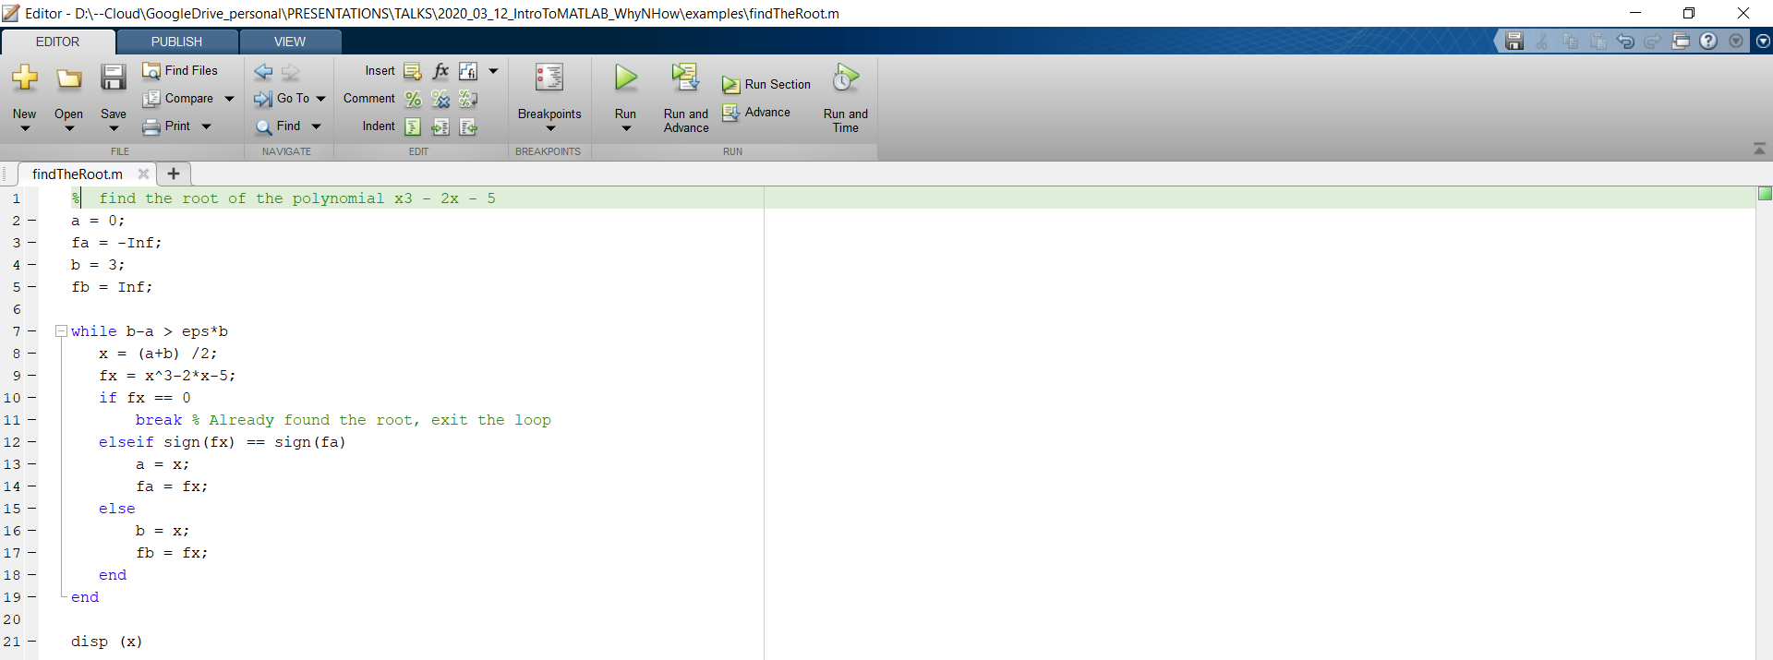
MATLAB’s EDITOR – M-file
Script m-file
It is a simple text file where you can place MATLAB commands
It will be executed top-to-bottom, one line at a time, as if you were typing the same commands in the console
Run directly (even portion of it, up to a single line): no need to be compiled
Save your works, and allows reproducibility
Notes:
Matlab’s editor is a dedicate text editor where you can write text and save it as an m-file.
- And m-file, at its core, is nothing more than a text file containing a sequence of Matlab instructions …
- that will be executed one at a time, top to bottom.
- Running a script produces the exact same results as if we were to execute each line of it in the command window …
- but it allows you to keep track of what you are doing, saving your script, and reuse it later on, maybe on a different dataset.

Slide 51
MATLAB’s EDITOR – M-file
Script m-file
It is a simple text file where you can place MATLAB commands
It will be executed top-to-bottom, one line at a time, as if you were typing the same commands in the console
Save your works, and allows reproducibility
Convenient for debugging
Run directly (even portion of it, up to a single line): no need to be compiled
A script shares same memory space from which it was invoked
Script works as if sequentially inserting the commands in the m-file at the command line
Be careful !
Notes:
It is as easy as it sounds, but this comes at the cost of some ‘security’ issues.
In fact, scripts do not have a dedicate memory space, and they share the same workspace as the command window.
This means that if we create a variable A using the console, and then we run a script which redefines a new variable A, we loose the original one and there is no coming back.
Being aware of this is a matter of practice, but it is something you need to be careful about while using scripts.

Slide 52
MATLAB’s EDITOR – M-file
function m-file
If you use a piece of code often, it is better to write it as a separate function.
The m-file begins with the keyword “function”.
The output argument(s) are in brackets [ ].
The input argument(s) are in parentheses ( ).
The file ends with the keyword “end”.
The name of the function and of the file should be the same!
Save this as m-file: compute_square.m
Notes:
If we want to have better control over what our code does, and which part of memory it can read and write, we can resort to a different type of m-file which is called ‘Function’.
Writing a function allows us to encapsulate a set of commands in a dedicate space, and to give them a name, an alias, we can use to call that piece of code multiple times during our processing.
The main difference between a script m-file and a function m-file is in the first row of the function file.
- It starts with a keyword ‘function’
- and closes with an ‘end’ keyword like we have seen for all Matlab statements that encloses a portion of our code.
- Then we can list a set of output variables using square brackets (which avoid the need of using return statements)
- and input variables using parenthesis.
- The body of the function will be used to process the inputs and to produce the outputs.
- We can then give a name to our function and save the file using the same name.

Slide 53
MATLAB’s EDITOR – M-file
function m-file
Once we save the function m-file, it may be called from a script or another function:
>> a = [1,2,3];
>> b = compute_square(a)
>> disp(b)
1 4 9
All parameters defined and used within a function reside in function’s own workspace and are deleted upon exiting the function.
Good to keep in mind!
Notes:
Choosing a unique name is important because that’s how we can call the function later on to use its functionalities.
And what’s good about functions is that, unlike scripts, they have their own memory space which does not interfere with the main workspace, so we are safe that the only way running a function will affect our code is through the outputs of the function themselves.

Slide 54
MATLAB’s EDITOR – M-file
Script or function m-file?
Scripts
Pros:
convenient; script’s variables are in same workspace as caller’s
Cons:
slow; script commands loaded and interpreted each time used
risks of variable name conflicts inside & outside of script
Functions
Pros:
Scope of function’s variables is confined to within function.
Easier debugging of input and outputs
Compiled the first time it is used; it runs faster subsequent times.
Easily be re-usable in another project.
Auto cleaning of temporary variables.
Cons:
I/O are highly regulated, if the function requires many pre-defined variables, it is cumbersome to pass in and out of the function – a script m-file is more convenient
Tip:
Use a script as your ‘main’ file, and refactor as much code as possible into as small as possible functions
Notes:
As a general rule, my suggestion is every time you need to write some code in Matlab
You try to refactor as much code as possible into as small as possible functions
And you write only one big script file, which will act as your main file that you can use to call as many functions as you can, either your own function, or the ones provided by some toolbox.

Slide 55
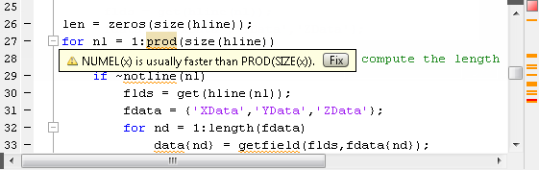
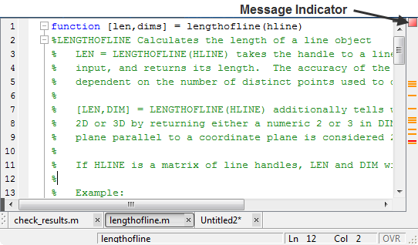
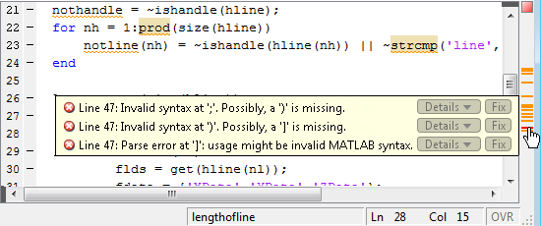
MATLAB’s EDITOR – Standard editor
Tips and tricks
Automatic code checking and programming tips
You can view warning and error messages about your code, and modify your file based on the messages. The messages update automatically and continuously so you can see if your changes addressed the issues noted in the messages.
Notes:
I said previously that Matlab editor is mostly a text editor. Well, a better definition of it is probably a text editor on steroids, as it has a lot, really a lot, of hidden functionalities to assist you while writing code.
One of the most interesting ones is that it continuously performs automatic code checking of what you are writing, giving you suggestions about how to improve your code, or warnings about errors you may have done.
You will see all of this on a sidebar on the right side of the editor window.
You can click on each marker to jump to the relevant line of code and read the message that the editor is trying to give you.

Slide 56
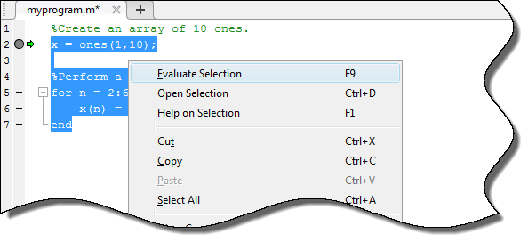
MATLAB’s EDITOR – Standard editor
Tips and tricks
Interactive debugging
To run piece of code: Highlight it & press F9:
Notes:
Using the editor you can also resort to one of the easiest ways to debug your code “live” while coding.
It is as easy as highlighting a section of your code and pressing F9: as long as al the variables needed by that snippet have already been defined in the workspace, you will immediately see the output pop out on the command window, so that you can check for errors, or just see if the outcome is what you were expecting.

Slide 57
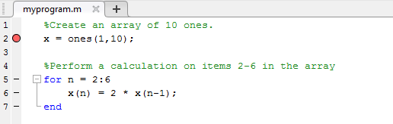
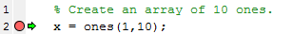
MATLAB’s EDITOR – Standard editor
Tips and tricks
‘PROPER’ debugging functionalities
Set breakpoints to pause the execution of a MATLAB file so you can examine the value or variables where you think a problem could be.
Run the file.
MATLAB pauses at the first breakpoint in the program.
While your code is paused, you can view or change the values of variables, or you can modify the code.
Press Continue to run the next line of code.
Notes:
Clearly, you can also choose to opt for more proper ways to debug your code, and this is done from the editor windows, as well.
Again, this is as simple as double-clicking a line number: this will create a breakpoint at that position and the next time you will run the script, the execution will stop right at that point for you to check if everything is going as expected.
You may place as many breakpoints as you want in your code, and while executing a green arrow while highlighting the current breakpoints.
Debugging is quite intuitive because there is no real ‘debug mode’: if there are breakpoints, running the script will stop at them, if there are no breakpoints, all the code will be executed.
That’s it.

Slide 58
MATLAB’s EDITOR – Standard editor
Tips and tricks
‘Use “cell mode” to improve code readability!
Inserting %% at the beginning of a line creates a cell, which is a block of code, within a script or a function
If you execute the whole file, cells will be ignored (they are NOT breakpoint)
But you can decide to evaluate just a single cell, and then jump to the next one (like F9 to evaluate a single line, but on steroids!)

Slide 59
MATLAB’s Graphical User Interface (GUI)
Notes:
While Matlab editor is super cool and full of functionalities, in the latest releases Mathworks added also a new type of editor called Live Editor, that you can open by clicking on the second button on the menu toolbar.

Slide 60
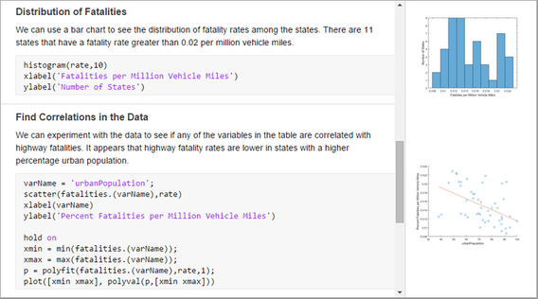
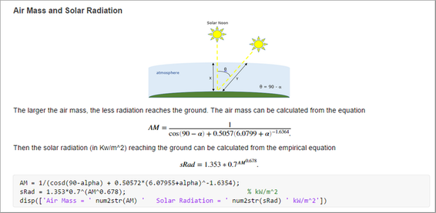
MATLAB’s EDITOR – Live editor
MATLAB live scripts and live functions are interactive documents that combine MATLAB code with formatted text, equations, and images in a single environment called the Live Editor. In addition, live scripts store and display output alongside the code that creates it.
Live scripts can be exported to PDF, Microsoft® Word, HTML, or LaTeX.
Notes:
It shares all the same basic functionalities of the basic editor, but can also combine MATLAB code with formatted text, latex equations, and images. In addition, live scripts can store and display output alongside the code that creates it
In this way you can also creaty high-quality report with code and results together, that you can save as PDF, HTML or LATEX.
Give it a try, because it’s really cool!
This is basically a duplicate of the idea behind project Jupyter, for those of you who know Python …
but don’t tell them I said that!

Slide 61

MATLAB’s EDITOR – Live editor
MATLAB live scripts and live functions are interactive documents that combine MATLAB code with formatted text, equations, and images in a single environment called the Live Editor. In addition, live scripts store and display output alongside the code that creates it.
Live scripts can be exported to PDF, Microsoft® Word, HTML, or LaTeX.
Notes:
It shares all the same basic functionalities of the basic editor, but can also combine MATLAB code with formatted text, latex equations, and images. In addition, live scripts can store and display output alongside the code that creates it
In this way you can also creaty high-quality report with code and results together, that you can save as PDF, HTML or LATEX.
Give it a try, because it’s really cool!
This is basically a duplicate of the idea behind project Jupyter, for those of you who know Python …
but don’t tell them I said that!

Slide 62
Overview
What?
WHY?
How?
Getting Started
Scripts, Functions, and the Editor
Visualization Tools
But … can I still use it, if I don’t know how to code?
Notes:
Ok, so, another interesting way Matlab can be very useful for people working in research and data analysis, is because it offers plenty of resources designed for the purpose of data exploration and visualization.

Slide 63
Overview
What?
WHY?
How?
Getting Started
Scripts, Functions, and the Editor
Visualization Tools
But … can I still use it, if I don’t know how to code?
Notes:
The following set of slides don’t want to be an exhaustive list of all the graphic functionalities provided by Matlab, but I thought that it could be interesting to provide you an overview of the most common ones and to show you how creating even very complex images is often a matter of calling one or two ad hoc functions.

Slide 64
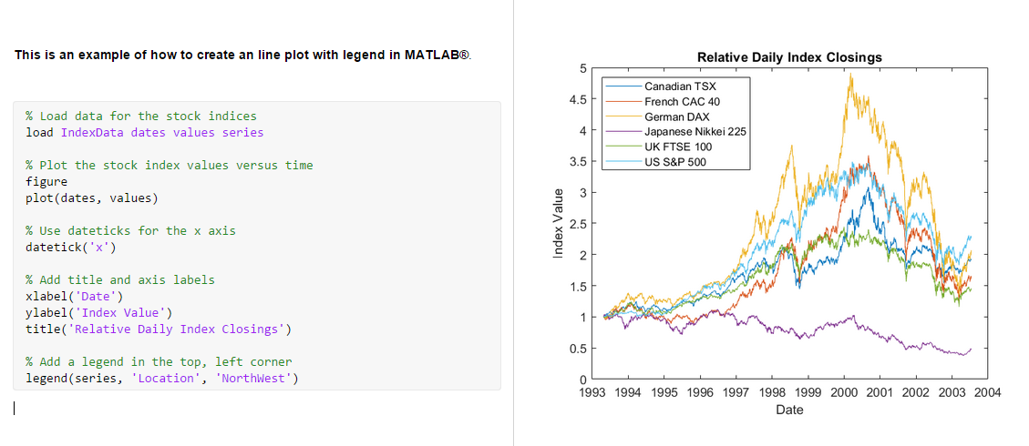
MATLAB Graphics
Plotting CURVES
Notes:
Let’s start with the simplest one, plotting arrays.
The function ‘plot’ requires 2 main inputs: an independent and a dependent variable.
And for the latter, it can also be a matrix: in which case, as shown here, all the rows in that matrix will be plotted on the graph versus the independent variable.
Then you can personalize almost everything: labels, axis name, title, legend, and so on.

Slide 65
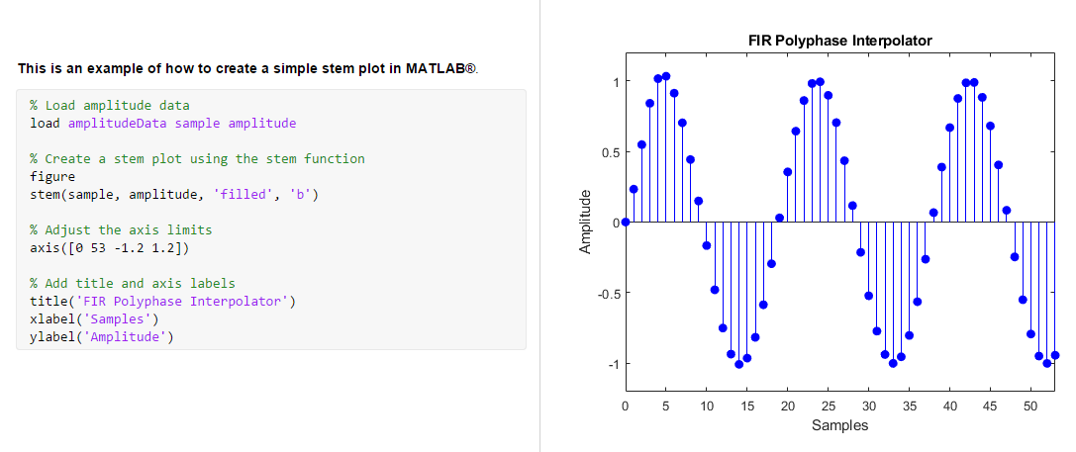
MATLAB Graphics
Plotting CURVES
Notes:
Let’s say you want to plot your signal highlighting the fact it is not time continuos: the function ‘stem’ offer you the same exact interface of ‘plot’, but with a totally different output.

Slide 66
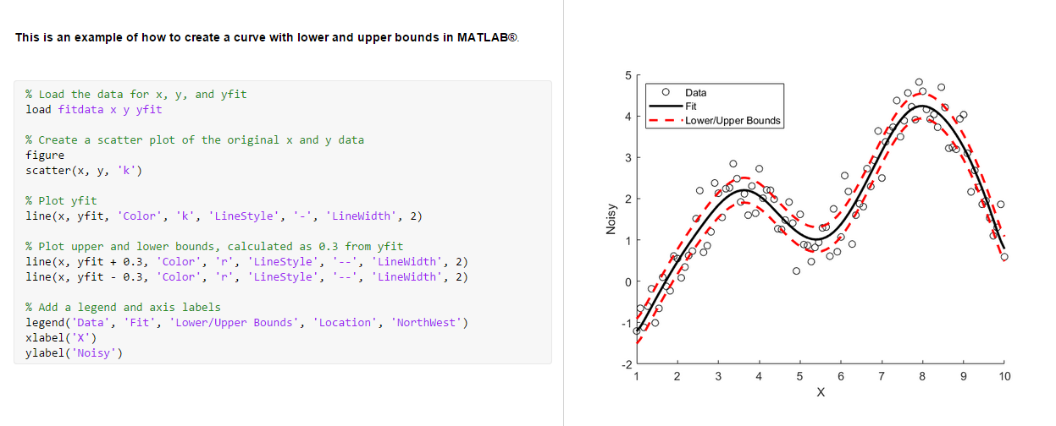
MATLAB Graphics
Plotting CURVES
Notes:
Let’s now imagine we have some data and we want to fit a model to it.
The results of our fitting would be a continuous curve and a confidence interval.
Well, the function ‘line’ uses the same interface as plot and allow us to easily show upper and lower confidence interval together with the result of the fitting.

Slide 67
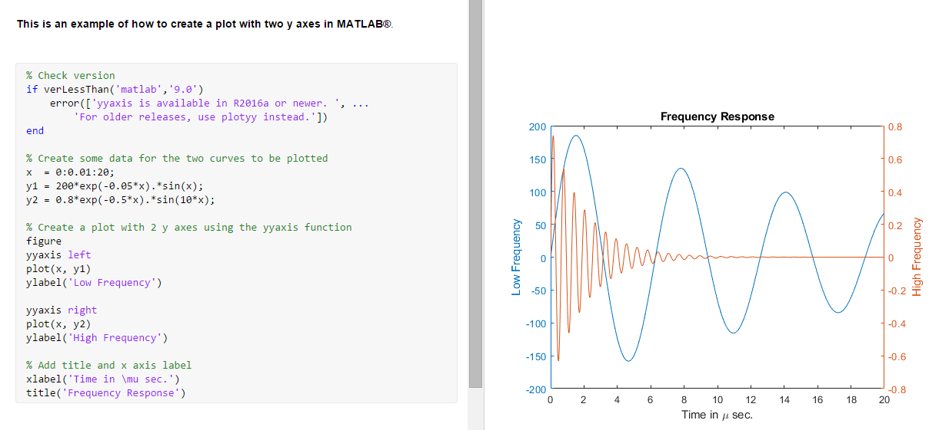
MATLAB Graphics
Plotting CURVES
Notes:
Something else that can happen is that we want to show two sets of data on the same plot, but if we use the same scale for the y axis, one of them will be almost invisible.
Well, using two different y axis on the same plot, in Matlab is just a matter of calling the right keyword, right before executing the plot command.

Slide 68
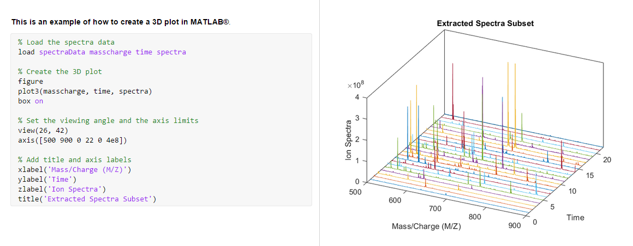
MATLAB Graphics
Plotting 3d datasets
Notes:
Clearly, 2D plots are not the only thing that can be done.
We can use the plot3 function to obtain 3D plots, very useful to show MR spectra, for instance.

Slide 69
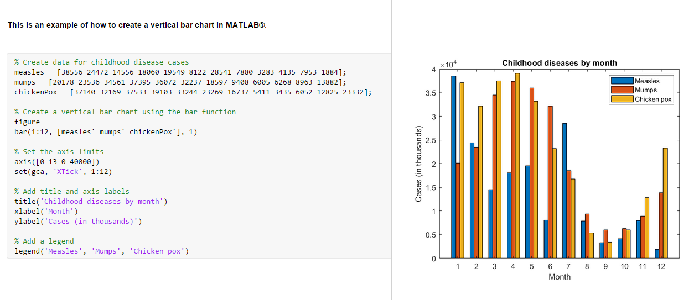
MATLAB Graphics
Plotting DATA / HISTOGRAMS / BARPLOTS
Notes:
Or bar, to obtain a bar plot that is by default able to group together data relevant to the same value of the x axis.

Slide 70
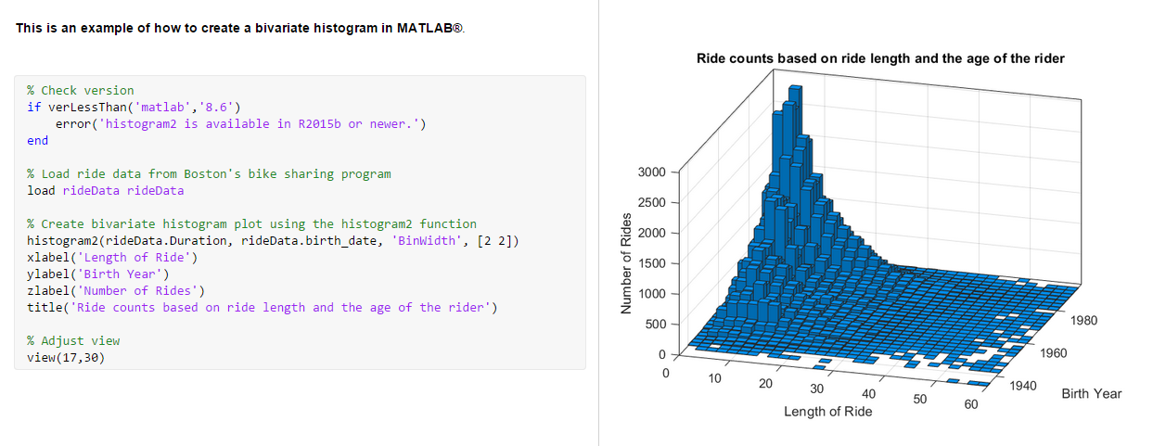
MATLAB Graphics
Plotting DATA / HISTOGRAMS / BARPLOTS
Notes:
Histogram, or histogram2 provide straightforward ways to compute and show histogram of arrays or matrices

Slide 71
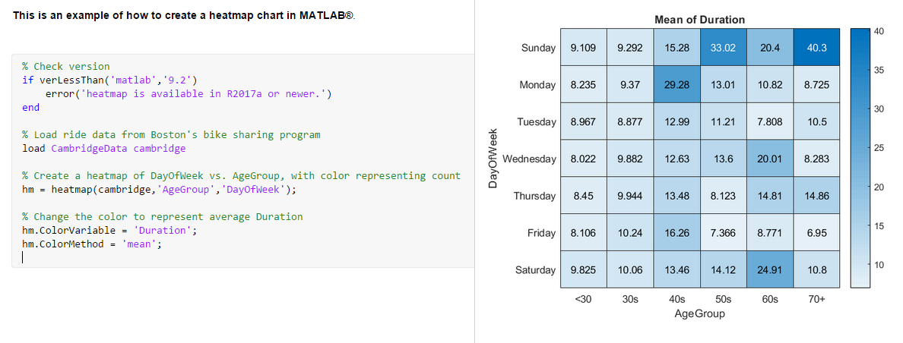
MATLAB Graphics
Showing Tabular data as heatmaps
Notes:
Than we have a new function, which has been introduced in the most recent version of Matlab, which is heatmap. Like histogram, more than just taking care of the visualization, it also computes the heatmap of the dataset passed as input, allowing us to select which variable to use to set the colorbar. Have you ever thought of using this function to show connectivity maps?

Slide 72
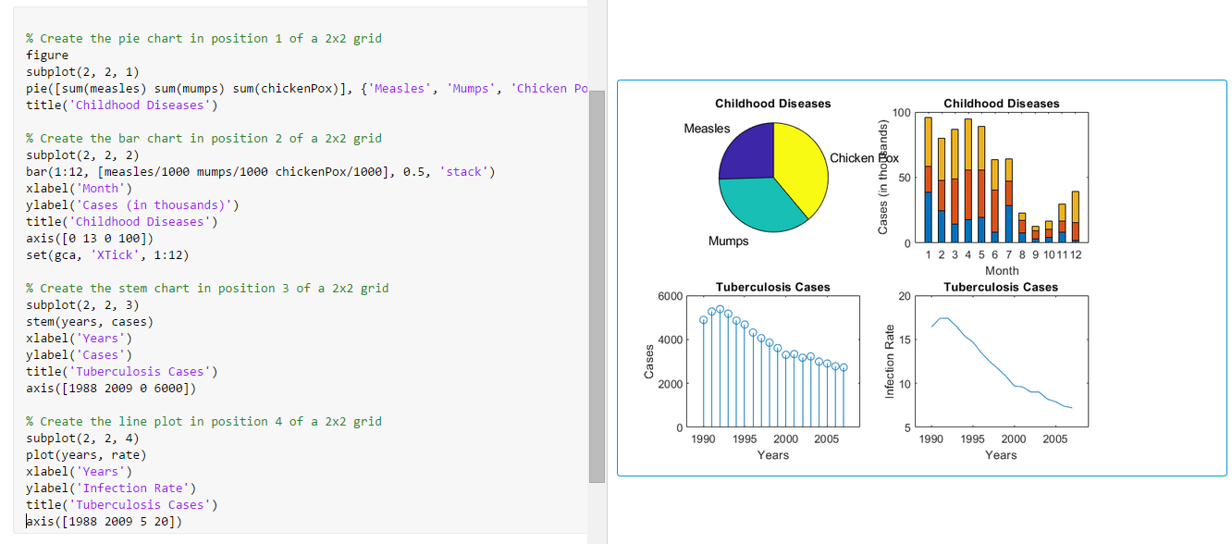
MATLAB Graphics
Assembling complex figures using subplots
Notes:
Then, of course, every plotting library worth of its name should give you the full power of assembling your figure as you see fit.
In Matlab, this is as simple as calling the function subplot before any other plotting instruction.
The first two inputs are the total number of rows and columns of the subplot grid, and the third one is the position in the grid we want to use for the current plot.
And now instead of having 4 separate figures, you have just one, with 4 subplots.

Slide 73
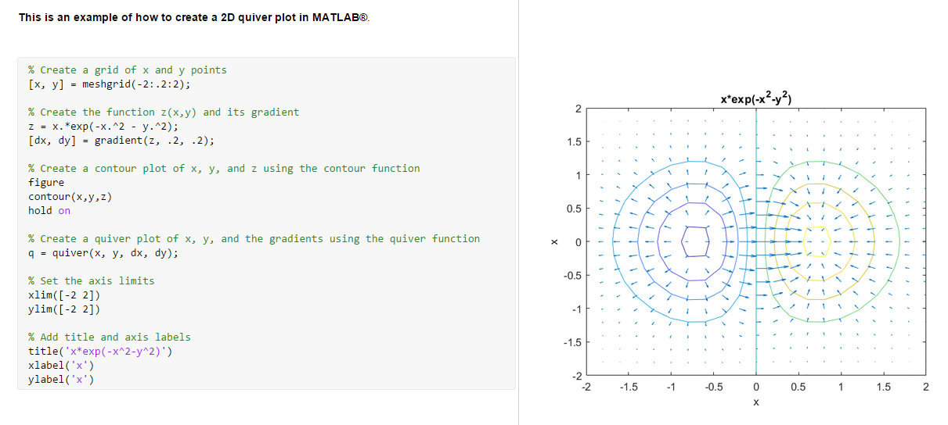
MATLAB Graphics
Visualizing 2D/3D vector fields
Notes:
You can also look at 2D and 3D vector fields, for instance if you want to study the magnetic field across a certain area, and to see its direction and how strong it is.
You can use the quiver function to just show all this arrows, whose length is based on the strength of the field in that point.

Slide 74


MATLAB Graphics
Visualizing 2D/3D vector fields
v(t)
v(t)
Rx
coil
Credits to Melissa Haskell
«Introduction to MATLAB», Why & How Series 2019
Notes:
You can also build a video or a GIF out of this field quiver plot.
For instance you can make the vector field time dependent, and show how the voltage changes across time.

Slide 75

MATLAB Graphics
Surface rendering with MATLAB

Slide 76

MATLAB Graphics
Surface rendering with MATLAB
Notes:
If you want to go even fancier, you can be interested in trying surface rendering, for which Matlab provides, between others, functions like surfc, or mesh,

Slide 77
MATLAB Graphics
Surface rendering with MATLAB
Discrete surface consists of “vertex points” and “edges”:
If you want to render your own mesh/surface in MATLAB, you need two lists of numbers:
“Vertices” are the coordinates of surface points.
“Faces” tell which three vertices form a given triangle.
Credits to Melissa Haskell
«Introduction to MATLAB», Why & How Series 2019
Notes:
which you can use to visualize brain meshing resulting from your freesurfer reconstruction.

Slide 78


MATLAB Graphics
DISPLAY IMAGES
Notes:
And what if you want instead to show images?
Well, you can use the ‘image’ function to let Matlab take care of everything or the ‘imagesc’ that allow you more control on the scaling of the visualization.
With both these functions, you can have fun changing colormaps until you find the best one for your specific purpose.

Slide 79

MATLAB Graphics
How crazy can you go?
isosurface
isonormals
isocaps
coneplot
streamline
patch
reducepatch
Notes:
But that’s just the tip of the iceberg.
How crazy you want to go with complex visualizations, is totally up to you, your imagination … and obviously, your data!

Slide 80
MATLAB Graphics
How crazy can you go?
Credits to Melissa Haskell
«Introduction to MATLAB», Why & How Series 2019
Notes:
All this visualizations were made using Matlab, so if you want to display a certain results, rest assured that there is probably a way that you can do it with Matlab.

Slide 81
Overview
What?
WHY?
How?
Getting Started
Scripts, Functions, and the Editor
Visualization Tools
But … can I still use it, if I don’t know how to code?
Notes:
Great, so, I began this presentation saying that I wanted to target an audience of people without a CS background, but so far, I have been just talking about writing code, defining variables, functions, scripts, and so on.
Well, is it true or not that you can use Matlab even without writing a single line of code?

Slide 82
Overview
What?
WHY?
How?
Getting Started
Scripts, Functions, and the Editor
Visualization Tools
But … can I still use it, if I don’t know how to code?
Notes:
Well, as weird as it may sound, while with all other languages, like C++, Python, and even R, to get something done you need to sit down and speak the same language as the compiler, Matlab has a lot of tools that allow people who don’t know how to code …

Slide 83
Overview
What?
WHY?
How?
Getting Started
Scripts, Functions, and the Editor
Visualization Tools
But … can I still use it, if I don’t know how to code?
want
Notes:
, or BETTER, that DON’T WANT to code, to enjoy it capabilities.

Slide 84
MATLAB’s own options
Notes:
And even better, you don’t need strange workarounds to do that, because a lot of functionalities are already available within Matlab itself.
Let’s see what I mean.

Slide 85

Matlab APPS
A MATLAB app is a self-contained MATLAB program with a user interface that automates a task or calculation.
All the operations required to complete the task (getting data into the app, performing calculations on the data, and getting results) are performed within the app.
Notes:
If we look at the menu toolbar, we can find a tab called APPS.
In there you can find a library of Matlab Apps, which are self-contained MATLAB programs that allow the user to complete a task just using an ad hoc user interface.
If you expand the drop-down menu …

Slide 86

Matlab APPS
Notes:
You will see a huge list of app that ready to be used.
Well, at least you will see all the apps that come with the toolboxes for which you bought a license, but that’s another story.
To understand what I mean, let’s see a couple of examples of such apps.

Slide 87


Matlab APPS
INTERACTIVE DATA IMPORT
Click ‘Import Data’ from the toolbar and select file, or …
… Drag & Drop data file in Command Window
Notes:
One of the most used and always available is the interactive data import app.
Let’s say you have done some processing, maybe in excel, and you have a CSV file you want to open in Matlab.
- You can either click the import data button,
- or drag and drop the file in the command window.

Slide 88

Matlab APPS
INTERACTIVE DATA IMPORT
Notes:
Either choice will fire up the interactive import app that will scan your file, trying to guess the best way to read it and showing you a preview.
- Once there, you may adjust some import parameter, like choosing a different column delimiter, if the autodetection somehow failed;
- or you can decide the type of workspace variable you want to use to read your file;
- you can choose a strategy to fill missing data,
- and eventually, you can import what has been read from your file.
Quite interesting, you can also save a script or a function for the input: in this way, next time you want to import the same type of file, you can just call the function instead of having to set all the parameters manually again.

Slide 89




Matlab APPS
INTERACTIVE DATA IMPORT
Notes:
Either choice will fire up the interactive import app that will scan your file, trying to guess the best way to read it and showing you a preview.
- Once there, you may adjust some import parameter, like choosing a different column delimiter, if the autodetection somehow failed;
- or you can decide the type of workspace variable you want to use to read your file;
- you can choose a strategy to fill missing data,
- and eventually, you can import what has been read from your file.
Quite interesting, you can also save a script or a function for the input: in this way, next time you want to import the same type of file, you can just call the function instead of having to set all the parameters manually again.

Slide 90

Matlab APPS
Curve fitting
Notes:
Ok, so let’s say now that the imported data are some time series we want to fit.
Well, instead of going through the doc and looking for the best way to write a function to fit our data, we could give a try at the curve fitting app available.
- This is as simple as selecting from the workspace the independent variable, and our noisy time series
- and picking a model from a dropdown menu.
- Depending on the chosen model we may have to set some additional parameters,
- or we may want to write down our own custom function.

Slide 91




Matlab APPS
Curve fitting
Notes:
Ok, so let’s say now that the imported data are some time series we want to fit.
Well, instead of going through the doc and looking for the best way to write a function to fit our data, we could give a try at the curve fitting app available.
- This is as simple as selecting from the workspace the independent variable, and our noisy time series
- and picking a model from a dropdown menu.
- Depending on the chosen model we may have to set some additional parameters,
- or we may want to write down our own custom function.

Slide 92

Matlab APPS
Curve fitting
Notes:
Once you are done, the app will immediately show us the fitted curve and the residual plots.
On the left panel we could read all the details about the estimated parameters, R squared, error and so on.
And if we like the result, we can export them to Matlab’s workspace.
And as before, we could also save a fit object that we may call later on to fit the same model to another dataset.
And all this without writing a single line of code ourselves.

Slide 93


Matlab APPS
Curve fitting
Notes:
Once you are done, the app will immediately show us the fitted curve and the residual plots.
On the left panel we could read all the details about the estimated parameters, R squared, error and so on.
And if we like the result, we can export them to Matlab’s workspace.
And as before, we could also save a fit object that we may call later on to fit the same model to another dataset.
And all this without writing a single line of code ourselves.

Slide 94

Matlab APPS
DICOM BROWSER
Notes:
Other interesting apps are for example the DICOM browser, which allows you to scan the header information of all dicoms in the current folder and provides also a few details and a preview of the images.
Once we find the right image, we may export it as a matrix, or send it to other apps for better visualization.

Slide 95

Matlab APPS
DICOM BROWSER
Notes:
Other interesting apps are for example the DICOM browser, which allows you to scan the header information of all dicoms in the current folder and provides also a few details and a preview of the images.
Once we find the right image, we may export it as a matrix, or send it to other apps for better visualization.

Slide 96

Matlab APPS
VOLUME VIEWER
Notes:
The volume viewer app, for instance, which in a few seconds gives us a 3D rendering or our scan with which we can play around adjusting light, camera angle, and so on.

Slide 97

Matlab APPS
IMAGE SEGMENTER
Notes:
Just to quickly mention a couple more, there is a barebone image segmenter

Slide 98


Matlab APPS
Deep learning network designer
Notes:
And also an entire deep learning network designer in which you can import pre-trained networks, study their structure, modifying it by simple drag and drop, and train.
Definitely, something you don’t usually see every day.

Slide 99


Mathworks File Exchange Platform
Sharing code, custom toolboxes and apps with other users
Notes:
Obviously, there are many more, but we won’t have time today to dug deeper into that library.
If we want to find a limit to what offered by the Matlab Apps library is certainly the fact that they are designed to cover the broader possible range of users and tasks.
If we are looking for an ultra-specific software for our research field, we may not be lucky enough to find it listed in the built-in apps.
But this doesn’t mean we won’t find it anywhere. If it is true the Matlab is a closed source commercial project, it is also true that the academic community using it is huge.
As a result, a lot of third-party tools have been developed over the years, and some of them are almost as good as commercial software on their own.
The first place to look for them is certainly the Mathworks File Exchange Platform, where everyone can upload new functions, scripts, apps, and so on, and everyone is free to download and use them.

Slide 100
(Neuro)Science community options
Notes:
At this point, I thought it could be interesting to see what the neuroscience community has been doing in the last few years in this field.
A little disclaimer:
1st - what follows doesn’t aim at being an exhaustive list of every tool available;
2nd – each one of this tool would require more than one day to be properly presented;
3rd – my goal here is just to show you a few examples what’s out there so that if you get curious about something, you can go ahead and see if it fits the kind of research you are doing.

Slide 101

EEGLAB
https://sccn.ucsd.edu/eeglab/index.php
EEGLAB is an interactive Matlab toolbox for processing continuous and event-related EEG, MEG and other electrophysiological data:
It provides a GUI to interactively process high-density EEG
It allows building and running batch or custom data analysis scripts
It offers a structured environment for storing, accessing, measuring, manipulating and visualizing event-related EEG data
It’s an open-source platform through which researchers can share new methods as EEGLAB plug-in functions
Notes:
Let’s start with EEGlab, a tool that if you work on EEG and MEG data you would probably know. It is built around an interactive GUI that allows you to process EEG and MEG data, and also to build custom scripts and processing pipeline to make it easy to replicate your experiment. It provides functions to
- study each channel location and field map,
- perform ICA decomposition, and also guided group analysis with very little knowledge about statistics required.
-------------------------------
1 – channel locations
2- ICA decomposition
3- Multiple Subject Processing ( guided Group analysis – with very little knowledge about statistic required)

Slide 102

EEGLAB
https://sccn.ucsd.edu/eeglab/index.php
EEGLAB is an interactive Matlab toolbox for processing continuous and event-related EEG, MEG and other electrophysiological data:
It provides a GUI to interactively process high-density EEG
It allows building and running batch or custom data analysis scripts
It offers a structured environment for storing, accessing, measuring, manipulating and visualizing event-related EEG data
It’s an open-source platform through which researchers can share new methods as EEGLAB plug-in functions
Notes:
Let’s start with EEGlab, a tool that if you work on EEG and MEG data you would probably know. It is built around an interactive GUI that allows you to process EEG and MEG data, and also to build custom scripts and processing pipeline to make it easy to replicate your experiment. It provides functions to
- study each channel location and field map,
- perform ICA decomposition, and also guided group analysis with very little knowledge about statistics required.
-------------------------------
1 – channel locations
2- ICA decomposition
3- Multiple Subject Processing ( guided Group analysis – with very little knowledge about statistic required)

Slide 103

EEGLAB
https://sccn.ucsd.edu/eeglab/index.php
EEGLAB is an interactive Matlab toolbox for processing continuous and event-related EEG, MEG and other electrophysiological data:
It provides a GUI to interactively process high-density EEG
It allows building and running batch or custom data analysis scripts
It offers a structured environment for storing, accessing, measuring, manipulating and visualizing event-related EEG data
It’s an open-source platform through which researchers can share new methods as EEGLAB plug-in functions
Notes:
Let’s start with EEGlab, a tool that if you work on EEG and MEG data you would probably know. It is built around an interactive GUI that allows you to process EEG and MEG data, and also to build custom scripts and processing pipeline to make it easy to replicate your experiment. It provides functions to
- study each channel location and field map,
- perform ICA decomposition, and also guided group analysis with very little knowledge about statistics required.
-------------------------------
1 – channel locations
2- ICA decomposition
3- Multiple Subject Processing ( guided Group analysis – with very little knowledge about statistic required)

Slide 104

EEGLAB - SIFT
https://sccn.ucsd.edu/wiki/SIFT
EEGLAB-compatible toolbox for analysis and visualization of multivariate causality and information flow between sources of electrophysiological (EEG/ECoG/MEG) activity.
Notes:
It’s also an open-source platform through which researchers can share new methods as EEGLAB plug-in functions, like SIFT, which is a tool to study causality and connectivity,

Slide 105

EEGLAB - BCILAB
https://sccn.ucsd.edu/wiki/BCILAB
MATLAB toolbox and EEGLAB plugin for the design, prototyping, testing, experimentation with, and evaluation of Brain-Computer Interfaces (BCIs), and other systems in the same computational framework.
Notes:
Or BCILAB, which is focused on the design and analysis of brain-computer interface experiments.

Slide 106

MNE
MEG/EEG source analysis
/usr/pubsw/packages/mne/stable/share/matlab/
https://mne.tools/stable/index.html
Notes:
Simply put, you can think of it as a competitor of our own MNE-toolbox, which used to have Matlab interface, but that I fear has been now replaced by the success of MNE python.

Slide 107

Statistical Parametric Mapping (SPM)
/usr/pubsw/common/spm
https://www.fil.ion.ucl.ac.uk/spm/
The SPM software is a suite of MATLAB functions and subroutines, designed for the analysis of brain imaging data sequences.
The sequences can be a series of images from different cohorts, or time-series from the same subject.
The current release is designed for the analysis of fMRI, PET, SPECT, and MEG.
Notes:
Another very famous Matlab-based tool is SPM.
Developed at UCL, this is a suite of many Matlab programs focused on the analysis of brain imaging data sequences, with a particular focus on functional imaging like fmri, pet, spect and meg.
It again offers a quite intuitive user interface that guide that guides the user through the entire processing pipeline,

Slide 108

Statistical Parametric Mapping (SPM)
Preprocessing
GLM
Statistics
Notes:
Taking care of everything
- from image registration, normalization to atlases,
- to the estimation of a GLM based on the functional task performed which produces a set of estimated parameters
- that are then shown as statistical maps.
Again, this description does not make justice to the tool, but I think that their training course is a multiday one, so bear with me on this very quick outline.

Slide 109

GIFT (Group ICA of fMRI Toolbox)
It is a MATLAB toolbox which implements multiple algorithms for independent component analysis and blind source separation of group (and single subject) fMRI data.
https://trendscenter.org/software/gift/

Slide 110

Masamune
http://people.fas.harvard.edu/~kastman/nwlabs_pipeline/pet-recon-mgh.html
Matlab tool for reconstruction of ‘BrainPET’ PET-MR data (Bay 6 )
Notes:
If you had the chance to work with data coming from the Siemens BrainPET scanner in Bay 6 here at the Martinos Center, you have already met Masamune, which is a Matlab tool for PET-MR image reconstruction maintained by people in Ciprian Catana’s Lab, to which I belong myself.
This tool takes care of everything from
- attenuation estimation and correction,
- to motion correction.
- It performs PET image reconstruction in such a way that MR and PET images are registered and in the same space.
- It provides also tools for exporting the final image in many different formats
- and also to prepare everything required by kinetic modeling when a dynamic dataset is acquired.

Slide 111

Masamune
http://people.fas.harvard.edu/~kastman/nwlabs_pipeline/pet-recon-mgh.html
Matlab tool for reconstruction of ‘BrainPET’ PET-MR data (Bay 6 )
Attenuation correction
Notes:
If you had the chance to work with data coming from the Siemens BrainPET scanner in Bay 6 here at the Martinos Center, you have already met Masamune, which is a Matlab tool for PET-MR image reconstruction maintained by people in Ciprian Catana’s Lab, to which I belong myself.
This tool takes care of everything from
- attenuation estimation and correction,
- to motion correction.
- It performs PET image reconstruction in such a way that MR and PET images are registered and in the same space.
- It provides also tools for exporting the final image in many different formats
- and also to prepare everything required by kinetic modeling when a dynamic dataset is acquired.

Slide 112

Masamune
http://people.fas.harvard.edu/~kastman/nwlabs_pipeline/pet-recon-mgh.html
Matlab tool for reconstruction of ‘BrainPET’ PET-MR data (Bay 6 )
Attenuation correction
Motion correction
Notes:
If you had the chance to work with data coming from the Siemens BrainPET scanner in Bay 6 here at the Martinos Center, you have already met Masamune, which is a Matlab tool for PET-MR image reconstruction maintained by people in Ciprian Catana’s Lab, to which I belong myself.
This tool takes care of everything from
- attenuation estimation and correction,
- to motion correction.
- It performs PET image reconstruction in such a way that MR and PET images are registered and in the same space.
- It provides also tools for exporting the final image in many different formats
- and also to prepare everything required by kinetic modeling when a dynamic dataset is acquired.

Slide 113

Masamune
http://people.fas.harvard.edu/~kastman/nwlabs_pipeline/pet-recon-mgh.html
Matlab tool for reconstruction of ‘BrainPET’ PET-MR data (Bay 6 )
Attenuation correction
Motion correction
Data reconstruction
File conversion
ROI segmentation
TAC analysis
Notes:
If you had the chance to work with data coming from the Siemens BrainPET scanner in Bay 6 here at the Martinos Center, you have already met Masamune, which is a Matlab tool for PET-MR image reconstruction maintained by people in Ciprian Catana’s Lab, to which I belong myself.
This tool takes care of everything from
- attenuation estimation and correction,
- to motion correction.
- It performs PET image reconstruction in such a way that MR and PET images are registered and in the same space.
- It provides also tools for exporting the final image in many different formats
- and also to prepare everything required by kinetic modeling when a dynamic dataset is acquired.

Slide 114
Masamune
http://people.fas.harvard.edu/~kastman/nwlabs_pipeline/pet-recon-mgh.html
Matlab tool for reconstruction of ‘BrainPET’ PET-MR data (Bay 6 )
Attenuation correction
Motion correction
Data reconstruction
File conversion
Notes:
If you had the chance to work with data coming from the Siemens BrainPET scanner in Bay 6 here at the Martinos Center, you have already met Masamune, which is a Matlab tool for PET-MR image reconstruction maintained by people in Ciprian Catana’s Lab, to which I belong myself.
This tool takes care of everything from
- attenuation estimation and correction,
- to motion correction.
- It performs PET image reconstruction in such a way that MR and PET images are registered and in the same space.
- It provides also tools for exporting the final image in many different formats
- and also to prepare everything required by kinetic modeling when a dynamic dataset is acquired.

Slide 115
Masamune
http://people.fas.harvard.edu/~kastman/nwlabs_pipeline/pet-recon-mgh.html
Matlab tool for reconstruction of ‘BrainPET’ PET-MR data (Bay 6 )
Attenuation correction
Motion correction
Data reconstruction
File conversion
ROI segmentation
TAC analysis
Notes:
If you had the chance to work with data coming from the Siemens BrainPET scanner in Bay 6 here at the Martinos Center, you have already met Masamune, which is a Matlab tool for PET-MR image reconstruction maintained by people in Ciprian Catana’s Lab, to which I belong myself.
This tool takes care of everything from
- attenuation estimation and correction,
- to motion correction.
- It performs PET image reconstruction in such a way that MR and PET images are registered and in the same space.
- It provides also tools for exporting the final image in many different formats
- and also to prepare everything required by kinetic modeling when a dynamic dataset is acquired.

Slide 116

Comkat (COmpartmental Model Kinetic Analysis Tool)
MATLAB software for compartmental modeling oriented to nuclear medicine applications (PET & SPECT). It supports models of a wide range complexity including multiple injection, receptor model with saturation:
It supports many image formats, including DICOM
Using either the command line interface or GUI, models are easily specified, solved or used to fit experimental data.
No mathematical derivations are required on the part of the user.
http://comkat.case.edu/
Notes:
Speaking of kinetic modeling, COMKAT was one of the first open-source tools to provide an alternative to commercial software like PMOD to perform pharmacokinetic modeling on PET and SPECT data.
It supports a wide set of models already implemented that the user can select just using a drop-down menu.

Slide 117


Comkat (COmpartmental Model Kinetic Analysis Tool)
Notes:
Interactive interfaces to deal with blood input function and region of interest selection are also provided so that no real command-line interaction is needed by the user.

Slide 118


MIAKAT
MIAKAT is a fully quantitative suite of analysis tools for PET neuroimaging data bringing together state of the art tools in a single user-friendly software environment.
It is implemented in MATLAB and it has a central GUI that facilitates “point and click” operation.
The user can configure an analysis pipeline for a given research study, and then simply replicate it for each dataset.
http://www.miakat.org/
Notes:
Speaking of kinetic modeling, MIAKAT is a newer software for the analysis of PET-MR dynamic data, which leverages a Matlab based GUI to provides a point and click access to a complex library of underlying functionalities for PET neuroimaging data processing .

Slide 119



MIAKAT
STANDARD BRAIN PIPELINE
take the primary experimental data (dynamic PET, structural MR images, arterial blood measurements)
perform a sequence of processes which ultimately produce results in regional (or voxel-wise) parameters
Brain Extraction
Brain Tissue Segmentation
Motion Correction
Regional ROI Definition via Atlas
Blood/Plasma Function Modelling
ROI Tracer Kinetic Modelling
Parametric Imaging
http://www.miakat.org/
Notes:
- The overall pipeline provided takes care of everything, from the coregistration of functional PET and structural MR data
- to the import of blood input data, to everything that lies in between having a time series of PET volumes and producing a set of parametric maps.

Slide 120
Overview
What?
WHY?
How?
Getting Started
Scripts, Functions, and the Editor
Visualization Tools
But … can I still use it, if I don’t know how to code?
want
Notes:
That was the last one, but again, it wasn’t meant to be an exhaustive list.
I just hope I captured your interest by talking about these virtuous examples of writing open source tools while using Matlab.

Slide 121
Overview
What?
WHY?
How?
Getting Started
Scripts, Functions, and the Editor
Visualization Tools
But … can I still use it, if I don’t know how to code?
want
Bonus: Miscellaneous “Advanced” Topics
Notes:
Before closing this webinar, however, I wanted to dedicate some time to the 3 viewers (I am optimistic, I know!) that may be interested in something a bit more ‘advanced’.

Slide 122
Using MATLAB @ Martinos Center
Notes:
I am going to start mentioning how we can use Matlab here, at the Martinos Center.

Slide 123
Opening MATLAB
If you are logged into any Linux workstation in Martinos Center
$ matlab & ← opens DEFAULT MATLAB version (NOT necessarily the LATEST version)
Other versions can be found as well (executable are in /usr/pubsw/bin/):
matlab matlab7.0 matlab7.11 matlab7.2 matlab7.4 matlab7.7 matlab7.9 matlab8.2 matlab8.4 matlab8.6 matlab9.2 matlab9.4 matlab9.6 matlab.new matlab6.5.1 matlab7.1 matlab7.14 matlab7.3 matlab7.5 matlab7.8 matlab8.0 matlab8.3 matlab8.5 matlab9.0 matlab9.3 matlab9.5 matlab9.7
Notes:
Well, the easiest way is to use any of the many Linux machines we have around.
While logged in to any of them, you can just type ‘matlab’ and the GUI we saw before will fire up and you will be up and running in no time.
The executable ‘matlab’ is linked to the default version of Matlab (which version this actually is I think is up the helpdesk).
It is not necessary the latest. However, there are many versions of Matlab installed in our server and you can use anyone you want by simply calling the right executable.

Slide 124
Using MATLAB from ‘your’ laptop
Use a Network License
This version only works when you are connected to the network inside the Partners firewall. https://www.nmr.mgh.harvard.edu/intranet/computer/software/matlab (Intranet login required).
Use remote access to your work desktop:
No Machine (software from Partners)
https://www.nmr.mgh.harvard.edu/intranet/computer/remote-access/nomachine
VNC (GUI access to Martinos workstations)
http://www.nmr.mgh.harvard.edu/martinos/userInfo/computer/vnc/windows.php
Standalone License
If you need a copy of Matlab that will work wherever you go you need to buy a standalone license. Contact Alyssa Silverman (Alyssa.Silverman@mathworks.com) for a quote and then submit the quote to whomever handles purchasing for your department.
Notes:
Second question: can you use Matlab from your laptop? Yes and no.
Matlab needs a license to run, but you can apply for a network license following this link.
- Network license, however, means that you will be able to use Matlab only while connected to a Partners network, either ethernet or wifi.
- Another option, probably the easiest one, is to use your laptop to remotely access one of the Martinos machines, and use Matlab from there. These links give you instructions on how you can do this.
- Ultimately, the only way to have Matlab with you all the time, also at home is to buy a standalone license.

Slide 125
MATLAB & launchpad
The center has limited numbers of MATLAB licenses.
All users are limited to no more than 20 MATLAB licenses in use at once over all locations (launchpad, tensor or your group workstations).
You can run MATLAB jobs in the cluster (launchpad)
http://www.nmr.mgh.harvard.edu/martinos/userInfo/computer/launchpad.php
Submit any jobs that use MATLAB to the queue matlab.
If your job requires any toolbox licenses, you are limited to just ONE such job running on the cluster.
To automate MATLAB jobs on the cluster, first create a *.m script file with your actual Matlab commands to run. The last line of the script should be 'exit’. Give a command like this to pbsubmit's -c option:
Another option is to "compile" your Matlab program into a stand-alone executable. This will not use up a license normally. https://www.nmr.mgh.harvard.edu/martinos/itgroup/deploytool.html
matlab.new -nodisplay -nodesktop -nojvm -r matlabfile
Notes:
- A part from that, we need to keep in mind that Martinos center has only a finite number of Matlab licences and toolboxes, and once they are all being used by people in the Center, the only thing you can do is wait for a license to free up.
- You also can use Matlab on our local cluster Launchpad. If you follow this link you will have all the information you may need.
- Let me just point out that Matlab jobs must be submitted to a dedicated queue, which will check also the number of license available and if you allowed to access all those that you require
- The way to prepare your code to work on the cluster is the same as you would do with a bash or a python script: you need to package your code in a script that could be executed directly from the command line, without requireìing any kind of interaction by the user.
- You also have the option of actually deploy your matlab program into an executable, but this is kind of high level and if you are interested you can find more details at this link here.

Slide 126
Calling MATLAB from SHELL
Notes:
Speaking of running Matlab scripts from command line, let’s see when this can be useful.

Slide 127
Running MATLAB scripts from SHELL
The MATLAB Editor is nice but:
Let us assume that you have a complicated SHELL processing stream using FSL & FreeSurfer tools.
You want to do a little bit of something in the middle with MATLAB that neither FSL or FS can do.
Then it is more convenient to run your MATLAB script from UNIX command line as part of your main script, without starting an interactive MATLAB session.
matlab.new -nodesktop -nodisplay -r "run /full/path/to/script/my_script”
NOTE
NO *.m extension in the script file name
Make sure last line of the file my_script.m is exit;
Notes:
Let’s say you have your nice bash script that does a lot of things, calling FSL, freesurfer and so on.
Let’s imaging for some reason, mid way through the execution, you want to do some processing in matlab.
Instead of stopping the bash script, opening up matlab and running manually a script, you can put a UNIX command like this in your bash filem where you are basically asking to execute a certain script without firing up matlab desktop interface.
If you do this, once Matlab is done, your oringal bash script can just proceed without requiring any intercation from you.

Slide 128
Calling Python (or anything else) from MATLAB
Notes:
And what if you want to do the opposite, calling other functions or command line tool while running a matlab script?

Slide 129


Calling Python from MATLAB
Using the default python sub-system
Specific only for Python
Similar functionalities also available for a handful of other languages
matlab_main.m
mymod.py
Notes:
Well, if you want to interact with Python, you are lucky, because Matlab now integrates a python subsytem you can use to execute python code natively.
Let’s say you have this very simple python module you want to call from Matlab.
To do that, in your main script you can just ‘import’ the module calling py.importlib.
This will add the module to your pythonpath, so that you can call the function declared in it by using again py.mymod.function name
As a result, the values returned by the python code will be immediately stored into matlab workspace variables.

Slide 130


Calling Python from MATLAB
Using the generic system call
We can use the system call
Can also do this with scripts from other programming languages
matlab_main.m
python_main.py
mymod.py
Notes:
There is also another option, which is not python specific and we can use for any script of any language, and it exploits ‘system’ calls.

Slide 131
Calling Python from MATLAB
Using the generic system call
We can use the system call
Can also do this with scripts from other programming languages
matlab_main.m
python_main.py
mymod.py
Notes:
There is also another option, which is not python specific and we can use for any script of any language, and it exploits ‘system’ calls.

Slide 132
Calling Python from MATLAB
Using the generic system call
We can use the system call
Can also do this with scripts from other programming languages
matlab_main.m
python_main.py
mymod.py
Notes:
There is also another option, which is not python specific and we can use for any script of any language, and it exploits ‘system’ calls.

Slide 133
Calling Python from MATLAB
Using the generic system call
We can use the system call
Can also do this with scripts from other programming languages
matlab_main.m
python_main.py
mymod.py
Notes:
There is also another option, which is not python specific and we can use for any script of any language, and it exploits ‘system’ calls.

Slide 134
Calling Python from MATLAB
Using the generic system call
We can use the system call
Can also do this with scripts from other programming languages
matlab_main.m
python_main.py
mymod.py
Don’t do this
if you just need Python, but …

Slide 135

Executing UNIX commands from MATLAB
Using the generic system call
What if I need an FSL command in the middle of an elaborate MATLAB processing pipeline?
b0
b0_brain
Notes:
What if we are note interested in Python code, but we need, for instance, to run an FSL command in the middle of a Matlab script?
In that case we don’t have dedicated subroutines, but we can leverage direct ‘system’ calls that provides Matlab with a direct interface to the command line.
Simply put, all you need to do is to create a matlab string with the command you want to run, exactly in the same way you will type it in a terminal window.
Then, if you pass that string to the system command, it will pass everything to the unix subsystem and execute the command.
Unlike python subsystem, in this case you don’t have a direct connection between the result and matlab’s workspace, so you will need to read and write result on disk to make matlab able to talk with other binaries called using ‘system’.

Slide 136
Speeding-up your code
Use functions instead of scripts.
Pre-allocate the final size of arrays.
Vectorize: Instead of writing loop-based code, consider using MATLAB matrix and vector operations.
Place independent operations outside loops.
Avoid programmatic use of cd, addpath, and rmpath, when possible: changing the MATLAB path during run time results in code recompilation.
Notes:
the biggest problem that scares CS people away from Matlab, which is its execution speed.
Matlab code, especially the code written by the average user (myself included) is almost always painfully slow.
This topic would require an entire hour by itself, so I will just give you a few hints so that if something catches your attention, you can go deeper and see how to do it.
- Use functions instead of scripts, because the first time you call a function the interpreter performs a sort of compilation, and from the following call, the execution will be faster.
- Preallocate array in which you want to save some output data: you can do that initializing them as zero-filled arrays.
- Try to avoid for loops as much as possible, because Matlab is REALLY bad at handling them.
- For the same reason, keep the body of a for loop as short as possible, and do as many operations as possible within it.
- Finally, DO NOT change the working directory or modify your path during execution: every time you do that the code will be recompiled affecting performance.

Slide 137


Parallel computing toolbox
Using parallel for-loop (PARFOR)
N.B. You cannot call scripts directly in a parfor-loop. However, you can call functions.
Notes:
If you really have to deal with for loop, Matlab offers you a very nice way to speed up your code by leveraging parallel execution.
Doing so, in Matlab is as easy as changing a keyword from ‘for’ to ‘parfor’.
The speed-up factor will clearly depend on the number of cores available on your machine, but you can trust me that you will see a difference ... or you can try It yourself!

Slide 138
Parallel computing toolbox
Using parallel for-loop (PARFOR)
N.B. You cannot call scripts directly in a parfor-loop. However, you can call functions.
Notes:
If you really have to deal with for loop, Matlab offers you a very nice way to speed up your code by leveraging parallel execution.
Doing so, in Matlab is as easy as changing a keyword from ‘for’ to ‘parfor’.
The speed-up factor will clearly depend on the number of cores available on your machine, but you can trust me that you will see a difference ... or you can try It yourself!

Slide 139
Parallel computing toolbox
Using parallel for-loop (PARFOR)
DO use ‘parfor’ loops
many loop iterations of a simple calculation
Loop iterations are “independent”
DON’T use ‘parfor’ loops
An iteration in your loop depends on the results of other iterations
You plan of using the matlab queue on launchpad
There’s no Parallel Computation TOOLBOX license available …
Notes:
Unfortunately, you cannot use parfors all the time, as this solution will usually work only
Using parfor on launchpad it’s – often – useless and it might break your license number limit

Slide 140

MATLAB Executable (MEX) File Functions
Call C/C++ or Fortran MEX file functions from MATLAB
MEX stands for MATLAB EXecutable.
A MEX file is a function, created in MATLAB, that calls a C/C++ program or a Fortran subroutine. A MEX function behaves just like a MATLAB script or function.
Two main components:
A gateway routine, mexFunction, that interfaces C/C++ and MATLAB data
Some non-MATLAB source code, that performs the desired computations
PROS
Fast calculations
Easy to learn and use
CONS
Slow implementation compared to M-files
Platform dependent (re)compilation
Notes:
Using parfor on launchpad it’s – often – useless and it might break your licence numbe limit

Slide 141


Thanks for joining!
That’s all folks!
mscipioni@mgh.harvard.edu
@mscipiotw

